Slide 1

Multi-Fidelity Analysis in SORCER
20th ISPE International Conference on Concurrent Engineering
RMIT University
Melbourne, Australia
2-6 Sept, 2013
Mike Sobolewski PJIIT
Scott Burton American Optimization LLC
Ray Kolonay US Air Force Research Lab

Slide 2
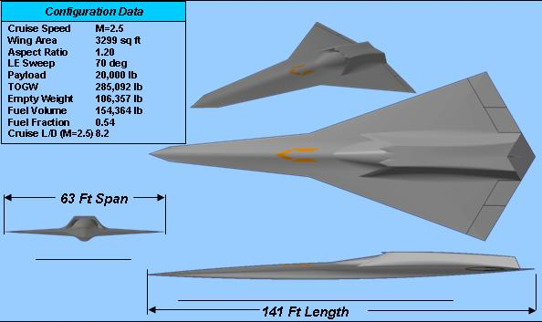
Typical Target Application
Efficient Supersonic Configuration
Baseline configuration and performance data from previous STAV and CESTA studies
Requirements:
Range = 4000 nmi
Payload = 5-10 % weight fraction
Maneuver Loads at Cruise – 2.5 g
Cruise speed: Mach 2.0
Cruise L/D: 8.5-9
Level 1 Flying Qualities

Slide 3
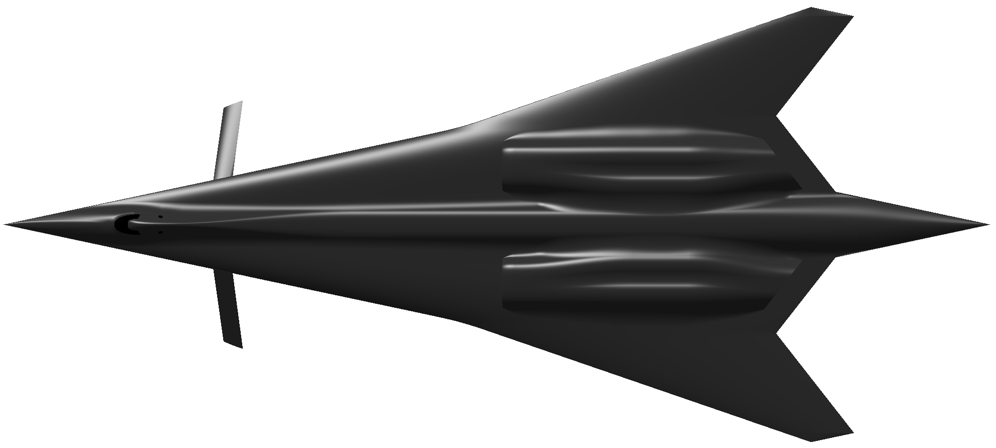
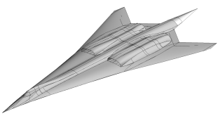
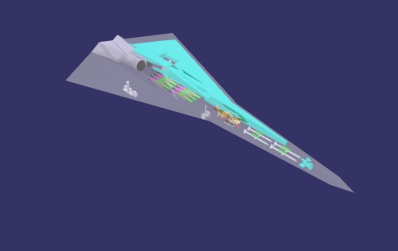
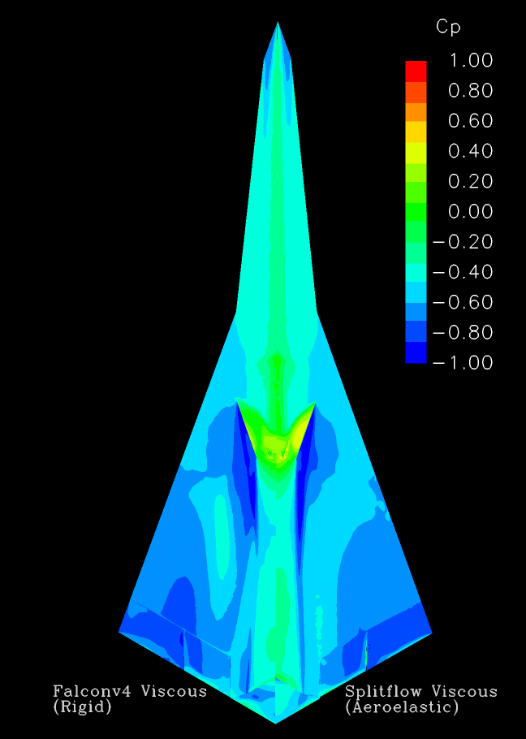
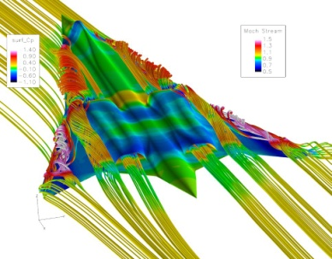
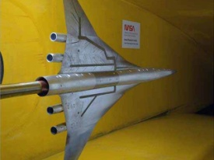
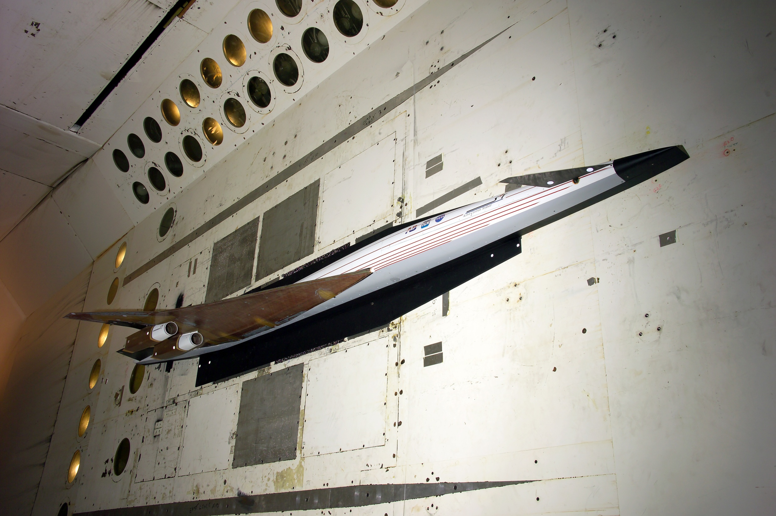
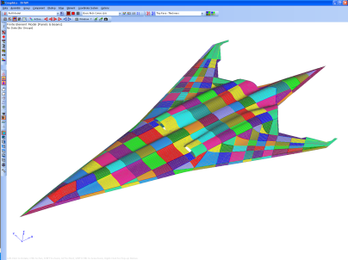
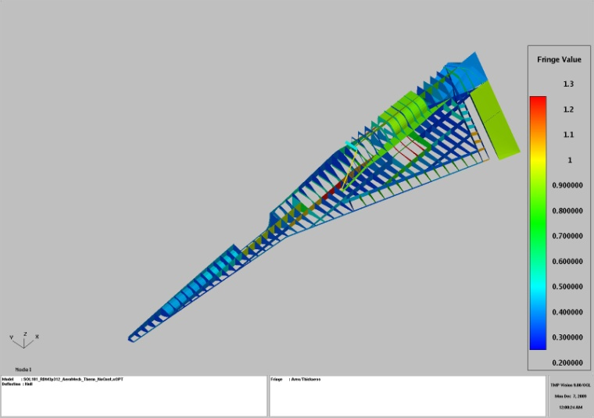
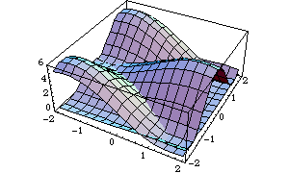
Merging Conceptual and Preliminary Design
1000s configurations
Technology
Suite
Conceptual Design Studies
Modeling for Design
10s configuration
Dr. Burton’s Presentation
My Presentations
Methods Application &
Technology Validation
Prototype
Experimental
Validation
Analysis for Design
Dialable “Appropriate” Fidelity with UQ
Design Space Exploration
Get more (and Better) Information … and get it Earlier
3

Slide 4
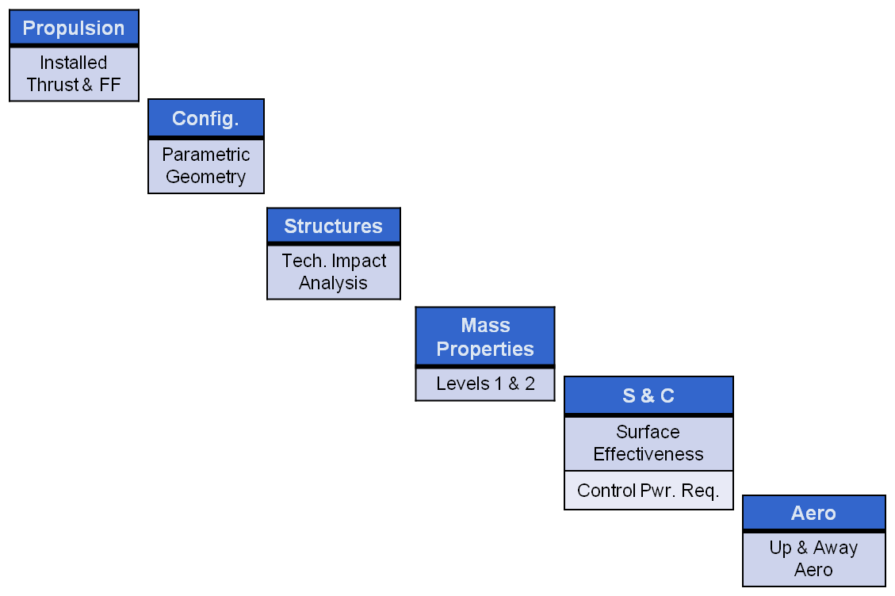
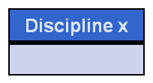
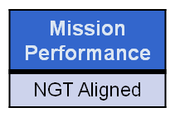
Design Process Vision
New Process Steps (BCA):
Increase Disciplines & Coupling
Increase Fidelity
Leverage All Compute Resources
Geographic Location A
Geographic Location B
Geographic Location C
Empirical
Linear Potential
Euler
NS
.
.
.
Dialable Fidelity
.
.
.
Physics Based Distributed Collaborative Design

Slide 5
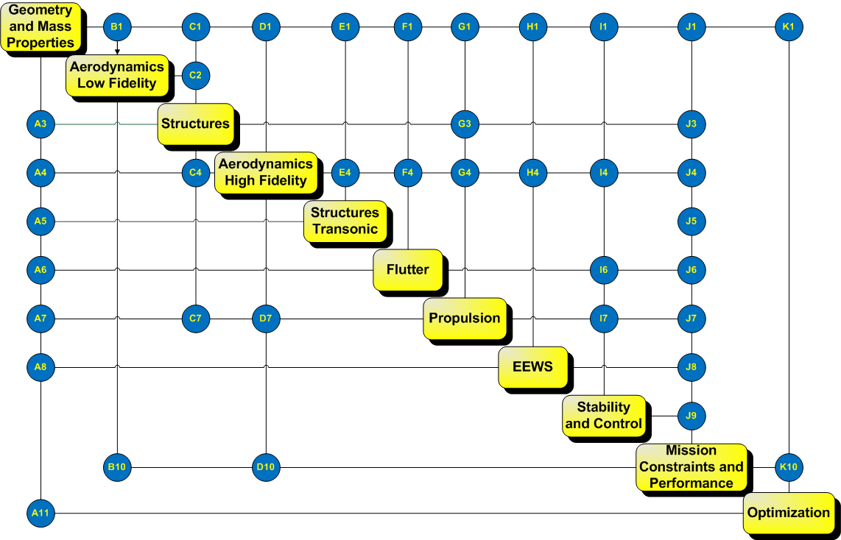
Multi-Fidelity Analysis
The same engineering quantity can be computed in many different fashions.
- Analytic expressions
- Historical databases/empirical relations
- Solutions to various levels of DE & PDE
- Surrogates to DE & PDE solutions
…
For Example - Induced Drag
- Closed form (high Aspect Ratio assumption)
- Treftz-Plane analysis
- Force integration
- Various Surrogates to the above
Analyst/Designer will need access to these different levels of fidelity depending on;
- Task at hand(Design Space Exploration, Validation etc..)
- Flight Condition
- Configuration being developed
The Computational Framework Needs to Support this Multi-Fidelity

Slide 6
Desired API
Anywhere on the network the enduser/developer should be able to do the following;
Var.getValue(method of Calculation)
Var.getGradient(method of Calculation)
Var is the enigneering quantity to be computed – Induced Drag for example
method of calculation is the fidelity level.
Use of Var anywhere else should not require changes if fidelity changes

Slide 7
SORCER Vars
Mathematics
Independent variables
Functions
Composite functions
Demand-driven
Multi-fidelity
Objects in Vars
Evaluator
Filter
Persister
Var: y1v
evaluator reference
evaluator value
y1v value
ExertionEvaluator
ExertionEvaluator
Task
ExertionEvaluator
Task
Signature
ExertionEvaluator
Task
Signature
Context
Task
Signature
Context
multi-fidelity
evaluator value
Signature
Context
evaluator value
Context
evaluator value
evaluator value

Slide 8
SORCER Evaluators
object to perform calculations
ExertionEvaluator
Uses remote services
Requires Task object
Service type
Service op
Provider name (optional)
Context (service op argument)
ExpressionEvaluator
MethodEvaluator
…
ExertionEvaluator
provider name
(optional)
Task
Signature
service type
Context
service op
evaluator value
Engineering Air Vehicle Provider
(AirVehicleInterface)
doMstcGeomService
executeAwave
provider name
service type
service ops
Notes:
Evaluators are used in SORCER Vars to create mathematical functions…

Slide 9

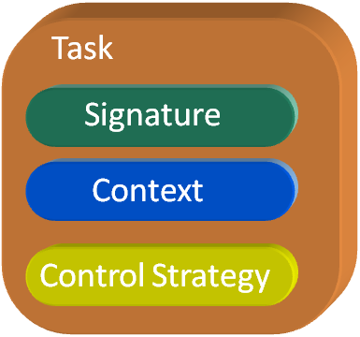
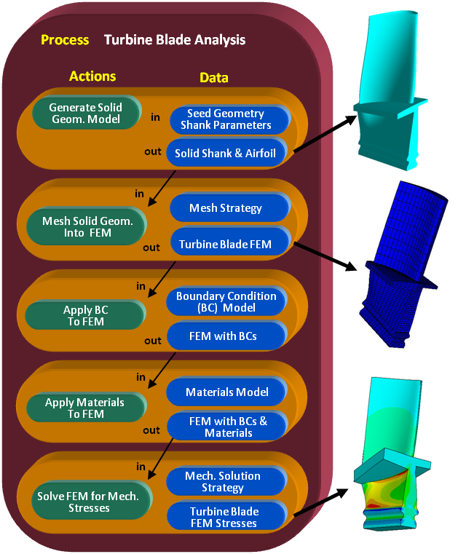
Exertion Evaluators
Elementary Exertion
Composite Exertion
Engineering Example
All are Objects

Slide 10
SORCER Vars
SORCER Filter
Operates on value returned from evaluator
Reduces or transforms
SORCER Persisters
Operates on value returned from filter
Sets value
Writes file
Passes to object
Var: y1
evaluator reference
filter
persister
evaluator value
y1 value
file
Var: y2
evaluator reference
filter
persister
evaluator value
y2 value
file
ExertionEvaluator
Task
Signature
Context
evaluator value
Notes:
Filters may be chained together to for a filter pipeline.

Slide 11
Var Structure
Functions of Functions
Variables
y1 | y2 | y3
Multidisciplinary
…
Multi-fidelity
Evaluators
y1e1 | y1e2
Drag via N-S Calc.
Drag via Surrogate Calc.
Differentiator
Gradient
y1e1g1
y1e1g2
dy1e1dx1
dy1e1dx2
dy1e1dx3
dy1e1dx4
dy1e1dx1e1 | dy1e1dx1e2
…
dy1e1dx1
dy1e1dx2
dy1e1dx3
dy1e1dx3
…
dy1e2dx1e1 | dy1e2dx1e2
Variables
dy1e1dx4e1 | dy1e1dx4e2
…
dy1e2dx4e1 | dy1e2dx4e2
…

Slide 12
SORCER Models
Collection of vars
May be published as a provider
Single model query
Set Xs, get Ys
Behaves like shared memory
Table model query
Rows of Xs
Creates new isolated model objects
Executes in parallel
OptimizationModel: model1
Var: x1v
Var: y1v
filter
Var: y2v

Slide 13
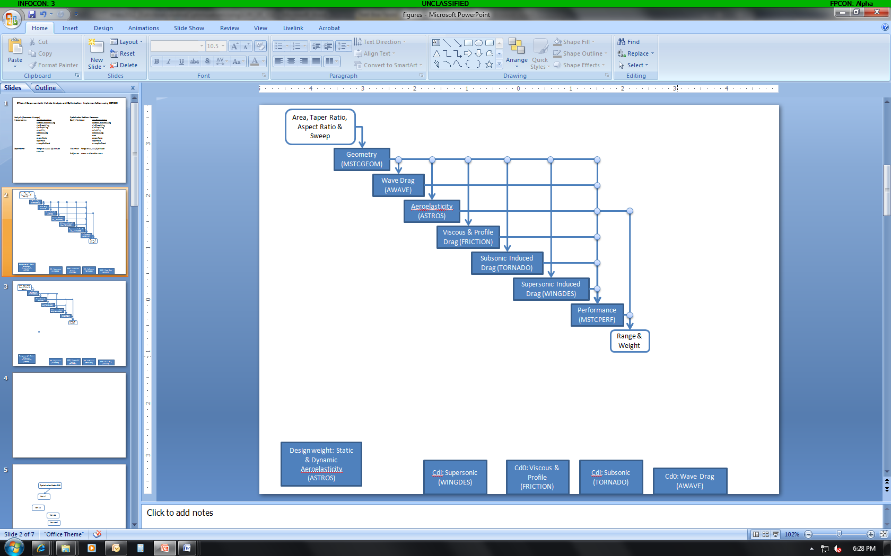
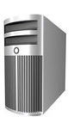
SORCER Provider
Java object in a JVM on a computer
Provide Java methods called service operations to remote users over a network
Implements a Java interface called a service type
JVM Process
provider name
Engineering Air Vehicle Provider
(AirVehicleInterface)
doMstcGeomService
executeAwave
service type
provider object
service ops
AirVehicleInterface
Context doMstcGeomService(Context ctx);
Context executeAwave(Context ctx);
service type
service ops
Notes:
Users don’t need to know where a provider is, nor it’s name (no host, port, or name required)

Slide 14
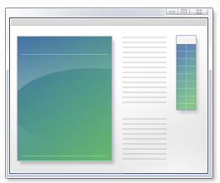
SORCER Services
Typically wrap engineering analysis executables
Java service code may augment native executables
Communication
File-based
Java Native Interface (JNI)
Java Native Access (JNA)
input file
Engineering Air Vehicle Provider
doMstcGeomService
executeAwave
writes
reads
executes
reads
awave.exe
writes
output file
Notes:
SORCER services are used by clients via the Evaluator object.

Slide 15
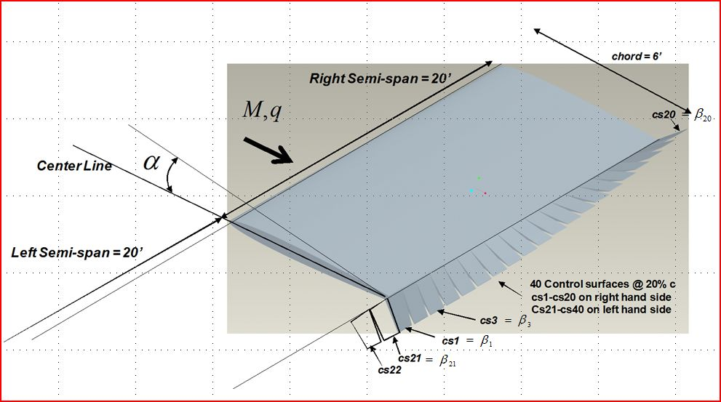
Model Example: Induced Drag Optimization

Slide 16
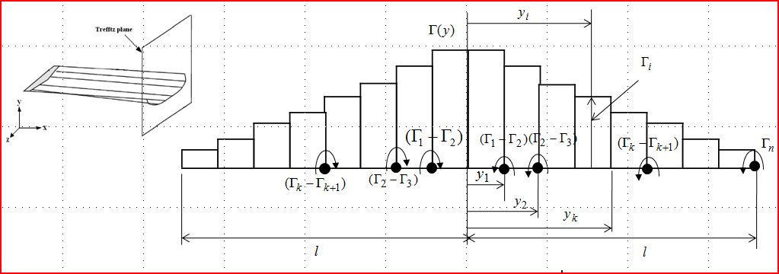
Trefftz-Plane Induced Drag
(Kutta-Joukowski theorem)

Slide 17
Optimization Problem
At Transonic Mach #’s Computation of Lpus requires Euler Solution

Slide 18
Fidelities for and
Linear Potential Method(LPM) | X | FFD | X | FFD
Standard One Point Approximation with LPM | X | Constant | X | Constant
Modified One Point Approximation with LPM |  |  | X | Semi-Analytic
Kriging with LPM |  |  | X
Euler Method (EM) | X | FFD | X | FFD
Standard One Point Approximation with EM | X | Constant | X | FFD
Modified One Point Approximation with EM |  |  | X | Semi-Analytic
Kriging with EM |  |  | X
Fidelity

Slide 19
SORCER Model Construction
Constructing a Model Consists of Two Steps
Model Definition (Skeleton)
Defines the model Variables (independent, dependent, parameters, objectives, constraints.
Defines the Variable Realizations, Evaluations, and Differentiation
Model Configuration (Muscle)
Develops the evaluators and filters for all variables and derivative variables.
Models can be created programmatically with or without
Operators (Functional Programming)

Slide 20
Engineering – Induced Drag Optimization Model Definition
OptimizationModel omodel = optimizationModel("Induced Drag”
designVars(vars(loop("i",1,20),"beta$i$", 0.2, -10.0, 10.0)),
linkedVars(names(loop("i",21,40),"betal$i$")),
designVars(var("alpha", 5.0, -5.0, 10.0)),
designVars(var("mach",0.75, 0.7, 0.85)),
designVars(var("q", 5.0, 4.5, 10.0)),
designVars(var("static pressure", -1., -1., 14.696))
parameter("gamma", 1.4),
dependentVar("DI",
realization(
evaluation("LinearPotentialExact", "DIAstrosExacte",
differentiation(wrt(names(loop("i",1,40),"Lpus$i$"),"q"), gradient("DIAstrosExacteg1"))),
evaluation("LinearPotentialSOA", "DIAstrosSOAe",
differentiation(wrt(names(loop("i",1,40),"Lpus$i$"),"q"), gradient("DIAstrosSOAeg1"))),
evaluation("LinearPotentialMOA", "DIAstrosMOAe",
differentiation(wrt(names(loop("i",1,40),"Lpus$i$"),"q"), gradient("DIAstrosMOAeg1"))),
evaluation("LinearPotentialKriging", "DIAstrosKriginge",
differentiation(wrt(names(loop("i",1,40),"Lpus$i$"), "q"), gradient("DIAstrosKrigingeg1"))),
evaluation("EulerExact", "DIAvusExacte",
differentiation(wrt(names(loop("i",1,40),"Lpus$i$"),"static pressure", "mach"), gradient("DIAvusExacteg1"))),
evaluation("EulerSOA", "DIAvusSOAe",
differentiation(wrt(names(loop("i",1,40),"Lpus$i$"),"static pressure", "mach"), gradient("DIAvusSOAeg1"))),
evaluation("EulerMOA", "DIAvusMOAe",
differentiation(wrt(names(loop("i",1,40),"Lpus$i$"),"static pressure", "mach"), gradient("DIAvusMOAeg1"))),
evaluation("EulerKriging", "DIAvusKriginge",
differentiation(wrt(names(loop("i",1,40),"Lpus$i$"), "static pressure", "mach"), gradient("DIAvusKrigingeg1")))
)
),

Slide 21
Engineering – Induced Drag Optimization Model Definition
dependentVars(loop("i",1,40),"Lpus$i$",
realization(
evaluation(”LinearPotentialExact", "LpusAstrosExacte",
differentiation(wrt(names(loop("k",1,20),"beta$k$"), "alpha", "q"), gradient("Lpus$i$AstrosExacteg1"))),
evaluation(”LinearPotentialSOA","Lpus$i$AstrosSOAe",
differentiation(wrt(names(loop("k",1,20),"beta$k$"), "alpha", "q"), gradient("Lpus$i$AstrosSOAeg1"))),
evaluation(”EulerExact", "LpusAvusExacte",
differentiation(wrt(names(loop("k",1,20),"beta$k$"), "alpha", "static pressure", "mach"), gradient("Lpus$i$AvusExacteg1"))),
evaluation(”EulerSOA","Lpus$i$AvusSOAe",
differentiation(wrt(names(loop("k",1,20),"beta$k$"), "alpha", "static pressure", "mach"), gradient("Lpus$i$AvusSOAeg1")))
)
),
objectiveVars(var("DIo", "DI", Target.min )),
constraintVars(var("LTc", "LT", Relation.eq, 1000.0))

Slide 22
Configuring the Variables in the Model
Consider the necessary Evaluators for
Configure the Evaluators
Exertion Evaluator Euler - Avus
LF
OF
EF
Configure the Evaluators
Method Evaluator “evaluateIDrag”
Induced Drag

Slide 23



Simple SORCER Network Configuration for Example
NMEDA – Linux Beau Wolf Cluster
Gladius – Linux Desktop
Astros (LPM) LPUS Calculations
Optimization Model – SOA, MOA, FFD
Calculations
AVUS Provider
Euler LPUS Calculations
Client
MacDNA – MACBookPro
SORCER Enables Seamless Access to All Methods, Models, Data, and Computing Resources
Sobolewski, M., Kolonay, R “Federated Grid Computing with Interactive Service-oriented Programming,” International Journal of Concurrent Engineering: Research & Applications, Vol. 14, No 1 2006 pp. 55-66

Slide 24
Model/Variable Use
Once the Variables & Model are configured (see paper for details)
Anywhere on the network the following API will work.
API Example 1:
// set “beta1” to 5.0
Omodel.getVar(“beta1”).setValue(5.0);
Omodel.getVar(“Lpus1”).getValue();
Behavior - kick off Lpus calculation (run the Avus Task) due to dependency of “Lpus1” on “beta1” (observe – observable pattern)
Omodel.getVar(“Lpusi”).getValue();
Behavior – Will NOT kick off Lpus calculation (run the Avus Task) since all “Lpusi” use the same evaluator(only different filters) and none of its dependencies have changed their values.

Slide 25
Model/Variable Use (Cont)
Omodel.getVar(“iDrag”).getDerivative(“Euler Exact”, “DIAvusExacteg1”, “beta1”, “beta2”, “beta15”)
Behavior - kicks off chain rule differentiation for
by FFD Evaluators run the Avus Task – Note only 4 Avus runs done )
done analytically by a Method Evaluator

Slide 26
Concluding Remarks
Very Brief Overview of SORCER that supports Large Scale Distributed MDMFMS-AO-UQ
Developed Computational Environment (Variable, Filter, Evaluator and Model) to support Functions of Functions and Mult-Fideltiy Analysis/Sensitives.
Anywhere on the network
Var.setValue(x)
Var.getValue(method of Calculation)
Var.getGradient(method of Calculation)
No need to change other code dependent on Drag

Slide 27
Questions?

Slide 28
SORCER Model
Models – consists of a collection of Variables.
Current available models – ResponseModel(including sensitivities) , ParametricModel,, OptimizationModel
Variables - can be dependent on other Variables enabling distributed functional programming. Variables can have multiple evaluators enabling multi-fidelity calculations for a specific variable’s value.
Current Variable Types - DESIGN, RESPONSE, DERIVATIVE, GRADIENT, RANDOM, BOUNDED, LINKED, PARAMTER
Evaluators – are used to determine the value of variables and their partial derivatives(chain rule works) with respect to their dependencies (Variables).
Current Evaluator Types – ModelEvaluator, ExertionEvaluator, ExpressionEvaluator, GroovyEvaluator, JepEvaluator, MethodEvaluator
Filters - are used to map the results of Evaluators to Variable Values. Think unix shell piping. Filters can be concatenated n times.
Current Filter Types – BasicFileFilter, ContextFilter, FileFilter, GrepFilter, ListFilter, MapFilter, ObjetFilter, PatternFilter, TextFilter
All are Objects

Slide 29
Rosen-Suzuki Functions
Model Definition
ResponseModel rm = ResponseModel(“Rosen-Suzuki Model",
designVars("x", 4), // creates 4 real design variables x1-x4
responseVars("f"), // creates 1 response variable f
responseVars("g", 3) //creates 3 response variables g1-g3
);

Slide 30
Rosen-Suzuki Functions
Model Configuration
// configure response vars
Evaluator fe = evaluator("fe", "x1^2-5.0*x1+x2^2-5.0*x2+2.0*x3^2-21.0*x3+x4^2+7.0*x4+50.0");
rm.setResponseEvaluator("f", fe);
fe.addArgs( om.getDesignVars("x1", "x2", "x3", "x4"));
Evaluator g1e = evaluator("g1e", "x1^2+x1+x2^2-x2+x3^2+x3+x4^2-x4-8.0");
rm.setResponseEvaluator("g1", g1e);
g1e.addArgs(om.getDesignVars("x1", "x2", "x3", "x4"));
Evaluator g2e = evaluator("g2e", "x1^2-x1+2.0*x2^2+x3^2+2.0*x4^2-x4-10.0");
rm.setResponseEvaluator("g2", g2e);
g2e.addArgs(om.getDesignVars("x1", "x2", "x3", "x4"));
Evaluator g3e = evaluator("g3e", "2.0*x1^2+2.0*x1+x2^2-x2+x3^2-x4-5.0");
rm.setResponseEvaluator("g3", g3e);
g3e.addArgs(om.getDesignVars("x1", "x2", "x3", "x4"));

Slide 31
Rosen-Suzuki Functions
Model Use
// you can set the value of the independent variables
rm.setDesignVarValues(set("x1", 2.0), set("x2", 3.0), set("x3", 4.0), set("x4", 200.0));
// get the values of the responses for the new x values
rm.getRepsonses();
Data Table [x1,x2,x3,x4, f, g1,g2,g3]
[2.0, 3.0, 4.0, 5.0, 46., 44.0, 71.0, 24.0]
// additional examples of using the api
Var x4 = rm.getDesignVar("x4");
logger.info("\n\nx4 value: " + x4.getValue());
x4 value: 5.0
// examine the responseVar f
Var f = rm.getResponseVar("f");
ExpressionEvaluator ee = (ExpressionEvaluator) f.getEvaluator();
logger.info("\n\nexpression:\n" + ee.getName() + "/" + ee.getExpression());
fe/x1^2-5.0*x1+x2^2-5.0*x2+2.0*x3^2-21.0*x3+x4^2+7.0*x4+50.0
logger.info("\n\nresponse:\n" + ee.getName() + "/" + f.getValue());
fe/46.0

Slide 32
Rosen-Suzuki Function Optimization Definition
Minimize
Subject to:

Slide 33
Objective Function, Constraints and Sensitivities
Objective Sensitivities:
Constraints Sensitivities:

Slide 34
Rosen-Suzuki Function Optimization
Optimization Model Definition
OptimizationModel om = optimizationModel("DesignExploration Model",
designVars(vars(loop(4), "x", 0.0,-100., 100.)),
responseVars("f"),
responseVars("g”,3),
objectiveVars(var("fo", "f", Target.min )),
constraintVars(var("g1c", "g1", Relation.lt, 0.0),
var("g2c", "g2", Relation.lt, 0.0),
var("g3c","g3", Relation.lt, 0.0)))
);

Slide 35
Rosen-Suzuki Function Optimization
Optimization Model Configuration
Sensitivity Evaluators for the Objective
Evaluator dfedx1e1 = evaluator("dfedx1e1", "2.0*x1-5.0",args(om.getDesignVars("x1")));
Evaluator dfedx2e1 = evaluator("dfedx2e1", "2.0*x2-5.0",args(om.getDesignVars("x2")));
Evaluator dfedx3e1 = evaluator("dfedx3e1", "4.0*x3-21.0",args(om.getDesignVars("x3")));
Evaluator dfedx4e1 = evaluator("dfedx4e1", "2.0*x4+7.0",args(om.getDesignVars("x4")));
List<Evaluator> feg1 = list(dfedx1e1, dfedx2e1, dfedx3e1, dfedx4e1);
om.setGradientEvaluators("f", "fe", "feg1", feg1);

Slide 36
Rosen-Suzuki Function Optimization
Optimization Model Configuration
Sensitivity Evaluators for the Constraints
Evaluator dg1edx1e1 = evaluator("dg1edx1e1", "2.0*x1+1",args(om.getDesignVars("x1")));
Evaluator dg1edx2e1 = evaluator("dg1edx2e1", "2.0*x2-1.0",args(om.getDesignVars("x2")));
Evaluator dg1edx3e1 = evaluator("dg1edx3e1", "2.0*x3+1.0",args(om.getDesignVars("x3")));
Evaluator dg1edx4e1 = evaluator("dg1edx4e1", "2.0*x4-1.0",args(om.getDesignVars("x4")));
List<Evaluator> g1eg1 = list(dg1edx1e1, dg1edx2e1, dg1edx3e1, dg1edx4e1);
om.setGradientEvaluators("g1", "g1e", "g1eg1", g1eg1);

Slide 37
Rosen-Suzuki Function Optimization
Optimization Model Configuration
Sensitivity Evaluators for the Constraints
Evaluator dg2edx1e1 = evaluator("dg2edx1e1", "2.0*x1-1",args(om.getDesignVars("x1")));
Evaluator dg2edx2e1 = evaluator("dg2edx2e1", "4.0*x2",args(om.getDesignVars("x2")));
Evaluator dg2edx3e1 = evaluator("dg2edx3e1", "2.0*x3",args(om.getDesignVars("x3")));
Evaluator dg2edx4e1 = evaluator("dg2edx4e1", "4.0*x4-1.0",args(om.getDesignVars("x4")));
List<Evaluator> g2eg1 = list(dg2edx1e1, dg2edx2e1, dg2edx3e1, dg2edx4e1);
om.setGradientEvaluators("g2", "g2e", "g2eg1", g2eg1);

Slide 38
Rosen-Suzuki Function Optimization
Optimization Model Configuration
Sensitivity Evaluators for the Constraints
Evaluator dg3edx1e1 = evaluator("dg3edx1e1", "4.0*x1+2.0",args(om.getDesignVars("x1")));
Evaluator dg3edx2e1 = evaluator("dg3edx2e1", "2.0*x2-1.0",args(om.getDesignVars("x2")));
Evaluator dg3edx3e1 = evaluator("dg3edx3e1", "2.0*x3",args(om.getDesignVars("x3")));
Evaluator dg3edx4e1 = evaluator("dg3edx4e1", "-1.0");
List<Evaluator> g3eg1 = list(dg3edx1e1, dg3edx2e1, dg3edx3e1, dg3edx4e1);
om.setGradientEvaluators("g3", "g3e", "g3eg1", g3eg1);

Slide 40
Rosen-Suzuki Function Optimization
Exploration
Explore Context
Explorer
Explorer#explore(Context):Context
register
update
Dispatcher
register search
ModelContext
Dispatcher#
notify:ModelContext
from model
SearchContext
Model
Optimizer
Modeling#update(Context):void
Modeling#model(Context):Context
Optimizer#processContext(SearchContext):SearchContext

Slide 41
Explorer Context (Data)
Explorer Context
VariableInfo
Optimization
Dispatcher
Model
Design Variable Info
Optimization State
Dispatcher Signature
Model Signature
Objectives Info
Optimization Strategy
Objectives Gradient Info
Optimization Signature
Constraints Info
Constraints Gradient Info

Slide 42
Standard One Point Approximation (SOA)
In terms of the induced drag function

Slide 43
Approximations
Linear Approximations
(First Order Taylor Series Expansion)

Slide 44
Inner/Outer Loop Optimization Algorithm
Exact Engineering Analysis
Outer Loop
minutes
to days
Control Program
Constraint Screening
Sensitivity Analysis
Inner Loop
Approximate Problem Generator
Approximate Analysis
Optimizer

Slide 45
Variable Structure
Functions of Functions
Variables
y1 | y2 | y3
Multidisciplinary
…
Multi-fidelity
Evaluators
y1e1 | y1e2
Drag via N-S Calc.
Drag via Surrogate Calc.
Differentiator
Gradient
y1e1g1
y1e1g2
dy1e1dx1
dy1e1dx2
dy1e1dx3
dy1e1dx4
dy1e1dx1e1 | dy1e1dx1e2
…
dy1e1dx1
dy1e1dx2
dy1e1dx3
dy1e1dx3
…
dy1e2dx1e1 | dy1e2dx1e2
Variables
dy1e1dx4e1 | dy1e1dx4e2
…
dy1e2dx4e1 | dy1e2dx4e2
…

Slide 46
Model Example: Induced Drag Optimization

Slide 47
Trefftz-Plane Induced Drag
(Kutta-Joukowski theorem)

Slide 48
Optimization Problem
At Transonic Mach #’s Computation of Lpus requires Euler Solution

Slide 49
Fidelities for and
Linear Potential Method(LPM) | X | FFD | X | FFD
Standard One Point Approximation with LPM | X | Constant | X | Constant
Modified One Point Approximation with LPM |  |  | X | Semi-Analytic
Kriging with LPM |  |  | X
Euler Method (EM) | X | FFD | X | FFD
Standard One Point Approximation with EM | X | Constant | X | FFD
Modified One Point Approximation with EM |  |  | X | Semi-Analytic
Kriging with EM |  |  | X
Fidelity

Slide 50
SORCER Model Construction
Constructing a Model Consists of Two Steps
Model Definition (Skeleton)
Defines the model Variables (independent, dependent, parameters, objectives, constraints.
Defines the Variable Realizations, Evaluations, and Differentiation
Model Configuration (Muscle)
Develops the evaluators and filters for all variables and derivative variables.
Models can be created programmatically with or without
Operators (Functional Programming)

Slide 51
Engineering – Induced Drag Optimization Model Definition
OptimizationModel omodel = optimizationModel("Induced Drag”
designVars(vars(loop("i",1,20),"beta$i$", 0.2, -10.0, 10.0)),
linkedVars(names(loop("i",21,40),"betal$i$")),
designVars(var("alpha", 5.0, -5.0, 10.0)),
designVars(var("mach",0.75, 0.7, 0.85)),
designVars(var("q", 5.0, 4.5, 10.0)),
designVars(var("static pressure", -1., -1., 14.696))
parameter("gamma", 1.4),
dependentVar("DI",
realization(
evaluation("LinearPotentialExact", "DIAstrosExacte",
differentiation(wrt(names(loop("i",1,40),"Lpus$i$"),"q"), gradient("DIAstrosExacteg1"))),
evaluation("LinearPotentialSOA", "DIAstrosSOAe",
differentiation(wrt(names(loop("i",1,40),"Lpus$i$"),"q"), gradient("DIAstrosSOAeg1"))),
evaluation("LinearPotentialMOA", "DIAstrosMOAe",
differentiation(wrt(names(loop("i",1,40),"Lpus$i$"),"q"), gradient("DIAstrosMOAeg1"))),
evaluation("LinearPotentialKriging", "DIAstrosKriginge",
differentiation(wrt(names(loop("i",1,40),"Lpus$i$"), "q"), gradient("DIAstrosKrigingeg1"))),
evaluation("EulerExact", "DIAvusExacte",
differentiation(wrt(names(loop("i",1,40),"Lpus$i$"),"static pressure", "mach"), gradient("DIAvusExacteg1"))),
evaluation("EulerSOA", "DIAvusSOAe",
differentiation(wrt(names(loop("i",1,40),"Lpus$i$"),"static pressure", "mach"), gradient("DIAvusSOAeg1"))),
evaluation("EulerMOA", "DIAvusMOAe",
differentiation(wrt(names(loop("i",1,40),"Lpus$i$"),"static pressure", "mach"), gradient("DIAvusMOAeg1"))),
evaluation("EulerKriging", "DIAvusKriginge",
differentiation(wrt(names(loop("i",1,40),"Lpus$i$"), "static pressure", "mach"), gradient("DIAvusKrigingeg1")))
)
),

Slide 52
Engineering – Induced Drag Optimization Model Definition
dependentVars(loop("i",1,40),"Lpus$i$",
realization(
evaluation(”LinearPotentialExact", "LpusAstrosExacte",
differentiation(wrt(names(loop("k",1,20),"beta$k$"), "alpha", "q"), gradient("Lpus$i$AstrosExacteg1"))),
evaluation(”LinearPotentialSOA","Lpus$i$AstrosSOAe",
differentiation(wrt(names(loop("k",1,20),"beta$k$"), "alpha", "q"), gradient("Lpus$i$AstrosSOAeg1"))),
evaluation(”EulerExact", "LpusAvusExacte",
differentiation(wrt(names(loop("k",1,20),"beta$k$"), "alpha", "static pressure", "mach"), gradient("Lpus$i$AvusExacteg1"))),
evaluation(”EulerSOA","Lpus$i$AvusSOAe",
differentiation(wrt(names(loop("k",1,20),"beta$k$"), "alpha", "static pressure", "mach"), gradient("Lpus$i$AvusSOAeg1")))
)
),
objectiveVars(var("DIo", "DI", Target.min )),
constraintVars(var("LTc", "LT", Relation.eq, 1000.0))

Slide 53
Configuring the Variables in the Model
Consider the necessary Evaluators for
Configure the Evaluators
Exertion Evaluator Euler - Avus
LF
OF
EF
Configure the Evaluators
Method Evaluator “evaluateIDrag”
Induced Drag

Slide 54
Simple SORCER Network Configuration for Example
NMEDA – Linux Beau Wolf Cluster
Gladius – Linux Desktop
Astros (LPM) LPUS Calculations
Optimization Model – SOA, MOA, FFD
Calculations
AVUS Provider
Euler LPUS Calculations
Client
MacDNA – MACBookPro
SORCER Enables Seamless Access to All Methods, Models, Data, and Computing Resources
Sobolewski, M., Kolonay, R “Federated Grid Computing with Interactive Service-oriented Programming,” International Journal of Concurrent Engineering: Research & Applications, Vol. 14, No 1 2006 pp. 55-66

Slide 55
Model/Variable Use
Once the Variables & Model are configured (see paper for details)
Anywhere on the network the following API will work.
API Example 1:
// set “beta1” to 5.0
Omodel.getVar(“beta1”).setValue(5.0);
Omodel.getVar(“Lpus1”).getValue();
Behavior - kick off Lpus calculation (run the Avus Task) due to dependency of “Lpus1” on “beta1” (observe – observable pattern)
Omodel.getVar(“Lpusi”).getValue();
Behavior – Will NOT kick off Lpus calculation (run the Avus Task) since all “Lpusi” use the same evaluator(only different filters) and none of its dependencies have changed their values.

Slide 56
Model/Variable Use
API Example 2:
// set “beta12” to -8.0
Omodel.getVar(“beta12”).setValue(-8.0);
Omodel.getVar(“DI”).getValue();
Behavior - kick off Lpus calculation (run the Avus Task) due to implicit dependency of “DI” on “beta12” (observe – observable pattern)

Slide 57
Model/Variable Use (Cont)
Omodel.getVar(“iDrag”).getDerivative(“Euler Exact”, “DIAvusExacteg1”, “beta1”, “beta2”, “beta15”)
Behavior - kicks off chain rule differentiation for
by FFD Evaluators run the Avus Task – Note only 7 Avus runs done )
done analytically by a Method Evaluator

Slide 58
Concluding Remarks
Very Brief Overview of SORCER that supports Large Scale Distributed MDMFMS-AO-UQ (Many references in the paper for detail)
Developed Computational Environment (Variable, Filter, Evaluator and Model) to support Functions of Functions and Mult-Fideltiy Analysis/Sensitives.
Anywhere on the network
Var.setValue(x)
Var.getValue(method of Calculation)
Var.getGradient(method of Calculation)

Slide 59
Rosen-Suzuki Function Optimization
Explorer Context
ExploreContext exploreContext = new ExploreContext("Rosen-Suzuki");
VarInfoList designInfo = varsInfo(varInfo("x1", 1.0), varInfo("x2", 1.0), varInfo("x3", 1.0), varInfo("x4", 1.0));
exploreContext.setDesignVarsInfo(designInfo);
exploreContext.setObjectivesInfo(null);
exploreContext.setObjectivesGradientInfo(null);
exploreContext.setConstraintsInfo(null);
exploreContext.setConstraintsGradientInfo(null);
ConminStrategy cmnStrategy=new ConminStrategy(new File(System.getProperty("conmin.strategy.file")));
exploreContext.setOptimizerStrategy(cmnStrategy);
//exploreContext.setOptimizerState(cmnState); // state initialized in Dispatcher after first Model update
// specify the Model
exploreContext.setModelSignature(signature("createModel", RosenSuzukiModelCreator.class, Type.INTRAPROCESS));
//specify the Optimizer
exploreContext.setOptimizerSignature(signature(null, ConminOptimizerJNA.class, Type.INTRAPROCESS));
// specify the explorer dispatched
exploreContext.setDispatcherSignature(signature(null, RosenSuzukiDispatcher.class, Type.INTRAPROCESS));

Slide 60
Rosen-Suzuki Function Optimization
Explorer Execution
outContext = (ExploreContext)explorer.explore(exploreContext);
********* CONMIN STATE **************
CONMIN Iteration # = 29
Objective Fuction fo = 6.00260795945281
Design Variable Values
x1 = 2.5802964087086235E-4 x2 = 0.9995594642481355 x3 = 2.000313835134211 x4 = -0.9986692050113675
Constraint Values
g1c = -0.002603585246998996 g2c = -1.0074147118087602 g3c = 4.948009193483927E-7
T
Termination Criterion
ABS(OBJ(I)-OBJ(I-1)) LESS THAN DABFUN = 5.0E-5 FOR 3 ITERATIONS
Evaluation Statistics
Number of Objective Evaluations = 88
Number of Constraint Evaluations = 88
Number of Objective Gradient Evaluations = 29
Number of Constraint Gradient Evaluations = 29
Analytic Optimum Results
fo = 6.0
X1=0.0, x2=1.0, x3=2.0, x4=-1.0
g1c=0.0, g2c=-1.0, g3c=0.0

Slide 61
Rosen-Suzuki Function Optimization
DEMO

Slide 62
MSTC SORCER Applications to Date
Hi-Fidelity Aeroelastic Analysis
Euler (AVUS), FEM (MSCNASTRAN), MDICE
Hi-Fidelity Induced Drag minimization
Euler (AVUS), Optimization (CONMIN, MATLAB)
2-D large amplitude airfoil motion trajectory Optimization
Unsteady Vortex Lattice Method (in-house UVLM), Opti (DOT)
Shape and sizing aeroelastic optimization
Euler (AVUS), FEM (MSCNASTRAN), MDICE, Opti (DOT) FD sensitivities
Small UAV MDO (aero, structures, acoustics, controls)
Efficient Supersonic Air Vehicle Design (ESAV)
Demonstrated tight integration with C, C++, and FORTRAN using JNA (can make direct calls to any shared object)
Network configuration
Linux workstations
Linux cluster(2), Mac cluster(1)
SGI Irix
Windows
Mac Desktop
Mac laptop

Slide 63
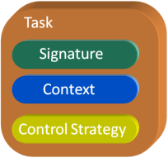
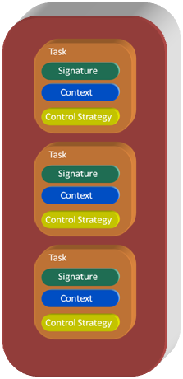

Exertion
Elementary Exertion
Composite Exertion
Engineering Example
Job
Job
.
.
.
All are Objects

Slide 64
Questions?

Slide 65
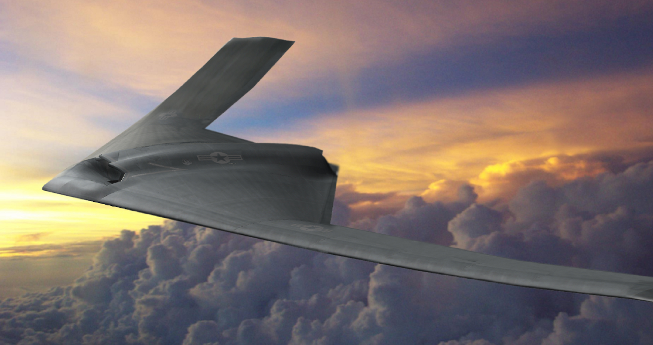
Induced Drag Optimization Motivation
Long duration on station
Large changes of over the mission

Slide 66
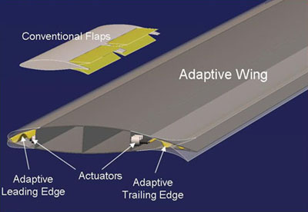
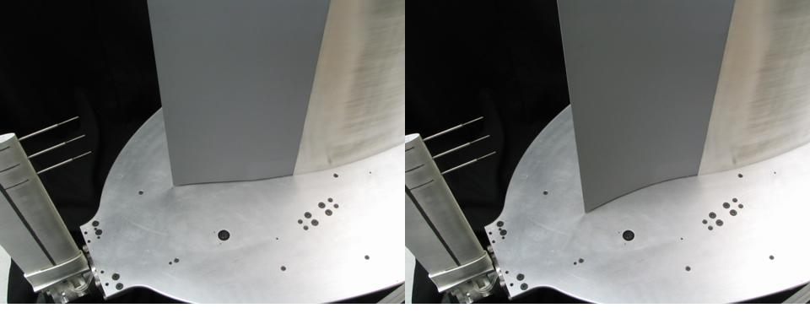
A Solution
Utilize conformal control surfaces to enhance laminar flow, minimize the Drag
Adaptive Compliant Wing
FlexSys Inc.

Slide 67
Modeling Conformal Control Surfaces

Slide 68
Trefftz-Plane Induced Drag With Euler Aerodynamics
(Kutta-Joukowski theorem)

Slide 69
Optimization Problem
At Transonic Mach #’s Computation of Lpus requires Euler Solution

Slide 70
Evaluators for Induced Drag and Sensitivities
Exact – Perform Euler solution for
By FD Euler Solutions
Standard One Point Approximation (SOA) – Perform Euler solutions
Modified One Point Approximation (MOA) – Perform Euler solution
Kriging – Perform Euler solutions (hundreds) for Kriging Model

Slide 71
Induced Drag Optimization Model
OptimizationModel omodel = optimizationModel("Induced Drag",
designVars(vars(loop("i",1,20),"beta$i$", 0.0, -10.0, 10.0)),
linkedVars(names(loop("i",21,40),"betal$i$")),
designVars(var("alpha", 5.0, -5.0, 10.0)),
designVars("mach", "gamma", "pstatic"),
responseVars(var("DI",
realization(
evaluation("DIExacte",
differentiation(wrt(names(loop("i",1,20),"beta$i$"), "alpha","q"), gradient("DIExacteg1"))),
evaluation("DISOAe",
differentiation(wrt(names(loop("i",1,20),"beta$i$"), "alpha","q"), gradient("DISOAeg1"))),
evaluation("DIMOAe",
differentiation(wrt(names(loop("i",1,20),"beta$i$"), "alpha","q"), gradient("DIMOAeg1"))),
evaluation("DIKrige",
differentiation(wrt(names(loop("i",1,20),"beta$i$"), "alpha","q"), gradient("DIKrigeg1")))))),
responseVars(var("LT",
realization(
evaluation("LTExacte",
differentiation(wrt(names(loop("i",1,20),"beta$i$"), "alpha","q"), gradient("LTExacteg1"))),
evaluation("LTSOAe",
differentiation(wrt(names(loop("i",1,20),"beta$i$"), "alpha","q"), gradient("LTSOAeg1"))),
evaluation("LTMOAe",
differentiation(wrt(names(loop("i",1,20),"beta$i$"), "alpha","q"), gradient("LTMOAeg1")))))),
responseVars(loop("i",1,20),"Lpus$i$",
realization(
evaluation("Lpus$i$Exacte",
differentiation(wrt(names(loop("k",1,20),"beta$k$"), "alpha"), gradient("Lpus$i$Exacteg1"))),
evaluation("Lpus$i$SOAe",
differentiation(wrt(names(loop("k",1,20),"beta$k$"), "alpha"), gradient("Lpus$i$SOAeg1"))))),
responseVars(var("q",
realization(evaluation("qExact", differentiation(wrt("mach","gamma","pstatic"), gradient("qExactg1")))))),
objectiveVars(var("DIo", "DI", Target.min )),
constraintVars(var("LTc", "LT", Relation.eq, 1000.0))
);

Slide 72
SORCER Network Configuration
Coalescence – Linux Beau Wolf Cluster
Nelson – SGI Irix 6.5
Numerical Analysis Provider
Gradient Calculations
AVUS Provider
Euler Drag
Calculations
DNA – Linux Desk Top
Optimization Provider
Approximations
CONMIN Optimization
Client
SORCER Enables Seamless Access to All Methods, Models, Data, and Computing Resources
Sobolewski, M., Kolonay, R “Federated Grid Computing with Interactive Service-oriented Programming,” International Journal of Concurrent Engineering: Research & Applications, Vol. 14, No 1 2006 pp. 55-66

Slide 73
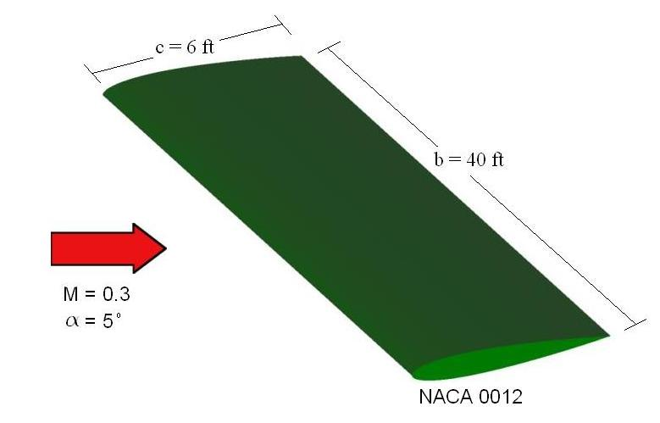
Example Case
Goland Wing Planform with a NACA 0006 Airfoil
(Euler Calculations- AVUS (1.5 million cells)
20 ft semi span
20 Control surfaces @ 20% c

Slide 74
Modified First Order Taylor Series Approximation
Comparison of Traditional and Modified First Order Taylor Series Expansion
 | Value | % Diff
Exact Function | 1.18388E-03 | 0.0%
Tradition First Order Taylor Series Expansion | -4.380E-04 | -137%
Modified First Order Taylor Series Expansion | 1.18708E-03 | 0.27%

Slide 75
Goland Wing M=0.85, Alpha=5.0
Square Error Objective
versus
Outer Loop Iteration
C_{L} per Span Versus Spanwise Strip
C_{L} per Span
Square Error
Iteration #
Spanwise strip
*Lift constraint satisfied to within 0.3%

Slide 76
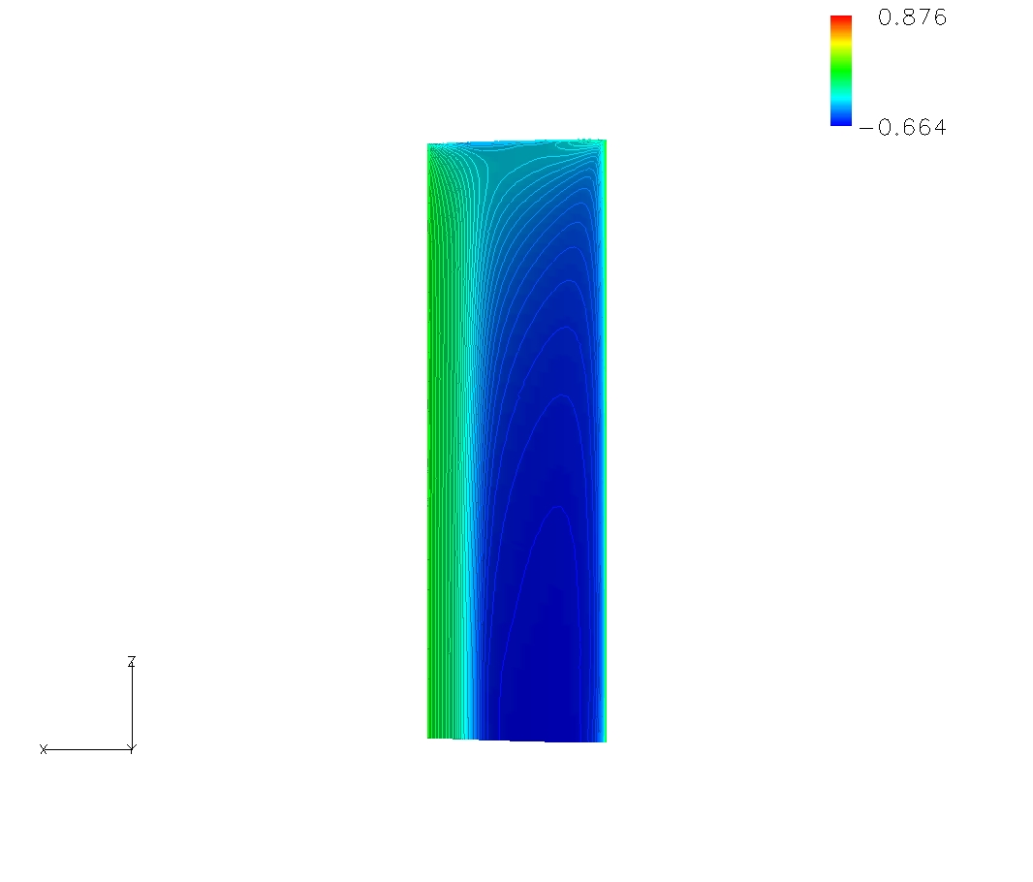
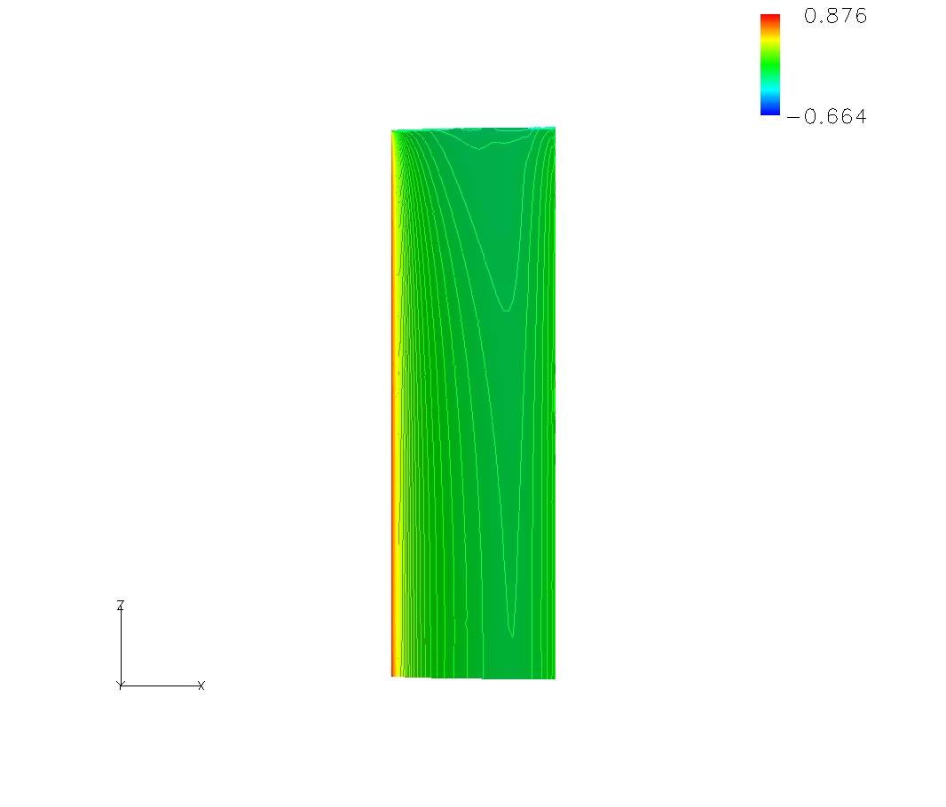
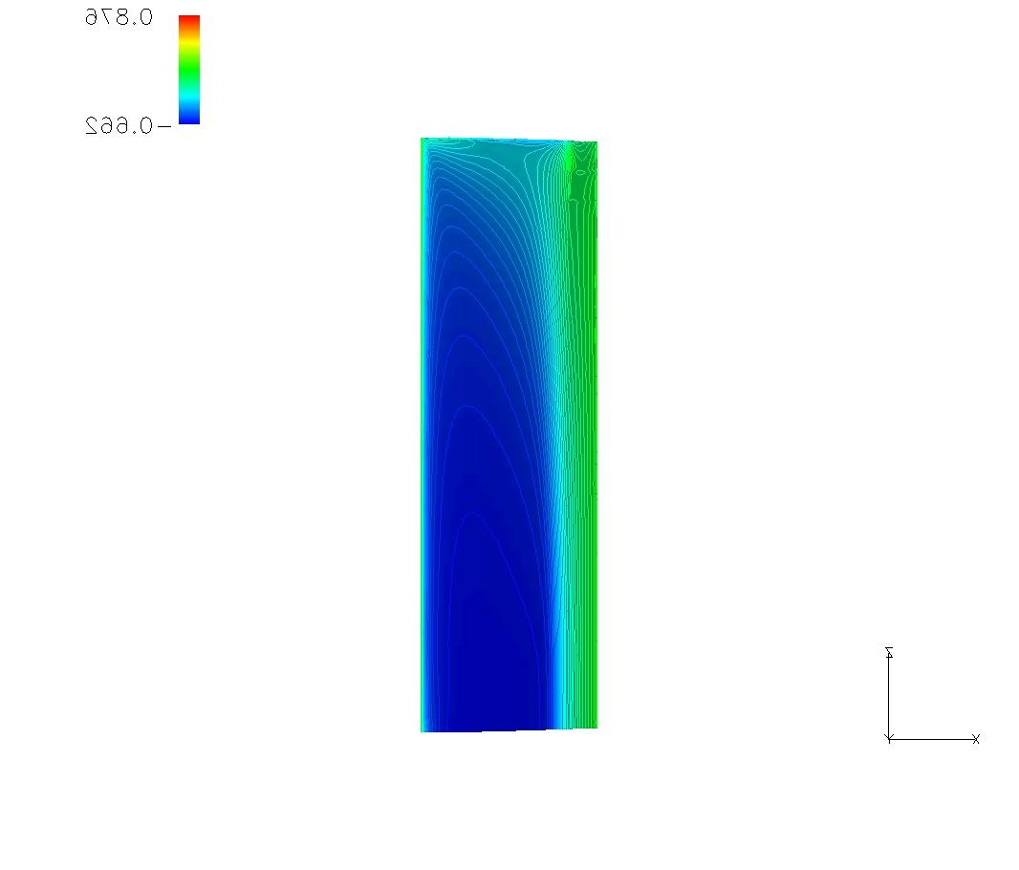
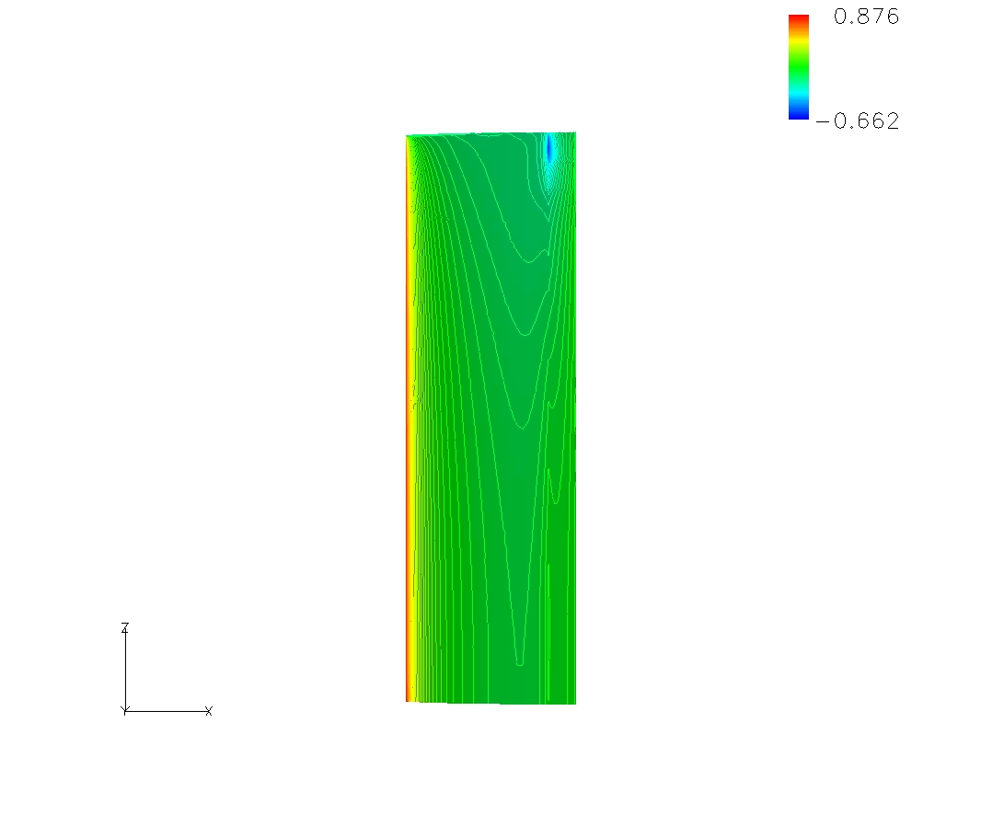
Goland Wing M=0.85, Alpha=5.0
0.876
Cp Initial
Cp Final
-0.662
Upper Surface
Lower Surface
Upper Surface
Lower Surface
degrees

Slide 77
Shape and Sizing Aeroelastic Optimization
Minimize
Objective Function
Subject to
Inequality
Constraints
Side
Constraints
- Structural sizes, and planform sweep
Ernest Thompson – AFRL/RBSD
Notes:
Challenges

Slide 78
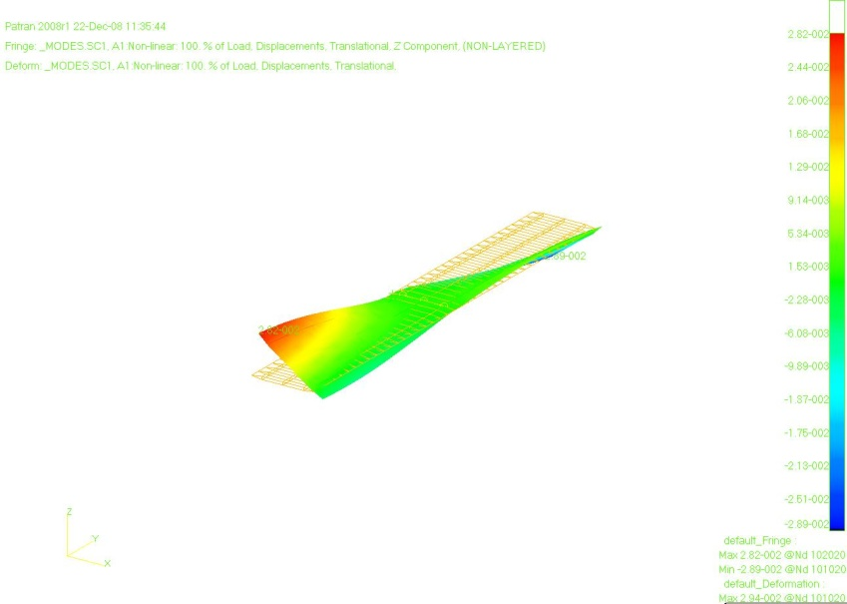
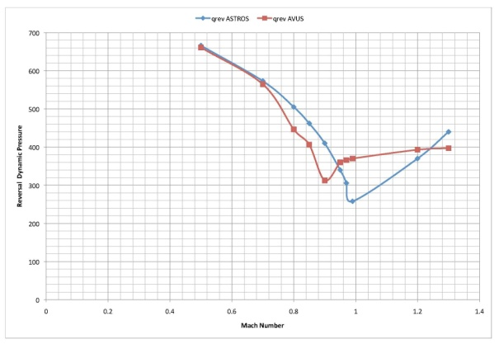
Min weight shape & sizing opti
- Euler Static Aeroelastic Calculations
q_rev
Mach
Ernest Thompson – AFRL/RBSD

Slide 79
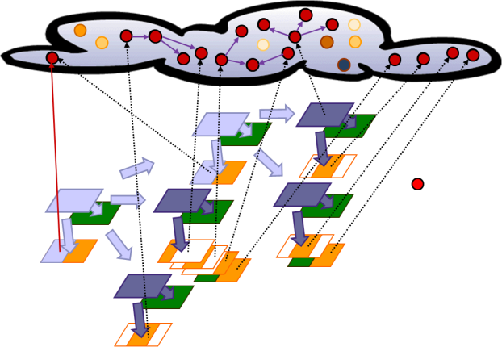










Sorcer network configuration for min weight (shape and sizing)
Coalescence
RBSDZ0010143
Avus
Whittle
NMEDA
Gladius
Client
Avus
Xserv2
Gothmog
Avus
Ernest Thompson – AFRL/RBSD

Slide 80
Concluding Remarks
Aerospace Vehicle Design requires executing large scale system level MDA/MDO in a heterogenous computing environment
SORCER exposes Sun’s Jini connection Technology to create a Model Oriented Programming (MOP) and computing environment for large scale MDA/MDO
SORCER Functionality
Create providers and expose them as jini services.
Exertion Oriented Programming – Ability to orchastrate Services
Models for analysis, sensitvitities, and design
VEF – Functional demand driven computations
Space Computing

Slide 81
Comments & Questions?

Slide 82
How to Determine the Compliant Surface Settings?
Approach 1. Indirect – Given a load distribution that is known to minimize drag, determine the control surface settings to obtain the desired load distribution.
Approach 2. Direct - Minimization of drag ( induced drag currently) using the conformal control surface settings.

Slide 83
Constructing a SORCER Response Model
Construct a Response Model for these functions.
The steps for constructing a Response Model are
1. Define the Model
2. Configure the Model

Slide 84
Defining a SORCER Response Model
Define the Model –
Define the Variables declaratively
VarOperator , Name of Variable(s) and complementary args for ValueType and MathType
Define the response & linked realizations for the Variables of Type:
Name of Evaluator(s) and list of Filter(s) for the Variable(s)
Define the derivative realizations for the Variable Sensitivities
Name of var, wrt vars, name of vector of evaluators (default FD Evaluators created)
Example: for the Rosen-Suzuki problem –
Variables: Type:DESIGN, Kind: BOUNDED, MathType:[REAL, CONTINUOUS],
ValueType: DOUBLE
Type:RESPONSE, ValueType:DOUBLE
See Appendix C for Details of Model and Variable Definition & Configuration

Slide 85
Defining a SORCER Response Model
Code for defining the Repsonse Model
ResponseModel rm = ResponseModel(“Rosen-Suzuki Model",
designVars("x", 4), // creates 4 real design varibles x1-x4
responseVars("f"), // creates 1 response variable f
responseVars("g", 3) //creates 3 response variables g1-g3
);
The above creates 4 DESIGN variables with names “x1-x4”, 4 RESPONSE variables “f” and “g1-g3”. There are many defaults used when using the minimum specification above.
The following attributes are default for Type DESIGN – the “xi”
ValueType: DOUBLE
MathType: [REAL, CONTINUOUS]
The following attributes are default for Type RESPONSE – the “f”, “gi”
Kind: [ ]
ValueType: DOUBLE
MathType: [REAL, CONTINUOUS]
The following realizations are default for Type RESPONSE – the “f”, “gi” ( default naming convention – variableNamee.)
realization(“f”, evaluation(“fe”),
realization(“g1”, evaluation(“g1e”),
realization(“g2”, evaluation(“g2e”),
realization(“g3”, evaluation(“g3e”)

Slide 86
Defining a SORCER Response Model
To specify the initial value and bounds on the DESIGN variables and specify the realizations for the RESPONSE variables:
ResponseModel rm = ResponseModel(“Rosen-Suzuki Model",
designVars(var(“x1”, 2.0, -100., 100.), var(“x2”,3.0,-100., 100.),
var(“x3”,4.0, -100, 100.), var(“x4”,5.0, -100, 100.),
responseVars("f"), // creates 1 response variable f
responseVars("g", 3) //creates 3 response variables g1-g3
realization(“f”, evaluation(“fe”),
realization(“g1”, evaluation(“g1e”),
realization(“g2”, evaluation(“g2e”),
realization(“g3”, evaluation(“g3e”)
);
The ResponseModel class has a very rich API

Slide 87
Defining a SORCER Response Model
If the DesignVariables all have the same initial Values and Bounds:
ResponseModel rm = ResponseModel(“Rosen-Suzuki Model",
designVars(vars(loop(“i”,1,20),“x$i$”, 0.0, -10.0, 10.0)),
responseVars("f"), // creates 1 response variable f
responseVars("g", 3) //creates 3 response variables g1-g3
realization(“f”, evaluation(“fe”),
realization(“g1”, evaluation(“g1e”),
realization(“g2”, evaluation(“g2e”),
realization(“g3”, evaluation(“g3e”)
);

Slide 88
Defining a SORCER Response Model
For the RESPONSE Variables to have sensitivities one must include them in the realization of the Variable during the definition of the model.
ResponseModel rm = ResponseModel(“Rosen-Suzuki Model",
designVars(var(“x1”, 2.0, -100., 100.), var(“x2”,3.0,-100., 100.),
var(“x3”,4.0, -100, 100.), var(“x4”,5.0, -100, 100.),
responseVars("f”,
realization((
evaluation(“fe”,
differentiation(wrt(loop(“i”,1,4),”x$i$”), gradient(“feg1”)),
responseVars(names(loop(“i“,1,3),g$i$”),
realization((names(loop(“i“,1,3),g$i$”
evaluation(“g$i$e”,
differentiation(wrt(loop(“k”,1,4),”x$k$”), gradient(“g$i$eg1”))
);
Once the Model is defined it must then be configured

Slide 89
Configuring a SORCER Response Model
Configuring a Response Model – This requires the definition of the EVALUATORS, and FILTERS (if present) for each of the RESPONSE and LINKED variables. For the Rosen-Suzuki case simple expression evaluators are used. No Filters are required.
// configure response variables
// NOTE: The evaluator names must match the one specified in the realization. There are several was to specify the args.
// configure f
var(model, "f", "fe",evaluator(“fe”, "x1^2-5.0*x1+x2^2-5.0*x2+2.0*x3^2-21.0*x3+x4^2+7.0*x4+50.0”), args(rm.getDesignVars()));
// configure g1
var(model, "g1", "g1e", "x1^2+x1+x2^2-x2+x3^2+x3+x4^2-x4-8.0", args("x1", "x2", "x3", "x4"));
// configure g2
var(model, "g2", "g2e", "x1^2-x1+2.0*x2^2+x3^2+2.0*x4^2-x4-10.0", args("x1", "x2", "x3", "x4"));
// configure g3
var(model, "g3", "g3e", "2.0*x1^2+2.0*x1+x2^2-x2+x3^2-x4-5.0", args("x1", "x2", "x3", "x4"));

Slide 90
Configuring a SORCER Response Model
Configuring a Response Model (cont) – If you have evaluators for the sensitivity calculations they need to be configured as well.
// configure the sensitivity model
// response f:fe="x1^2-5.0*x1+x2^2-5.0*x2+2.0*x3^2-21.0*x3+x4^2+7.0*x4+50.0"
// derivativeResponse dfdx1:dfedx1 = "2.0*x1-5.0"
// derivativeResponse dfdx2:dfedx2 = "2.0*x2-5.0"
// derivativeResponse dfdx3:dfedx3 = "4.0*x3-21.0"
// derivativeResponse dfdx4:dfedx4 = "2.0*x4+7.0"
Evaluator dfedx1e1 = expression("dfedx1e1", "2.0*x1-5.0",args(sm.getDesignVar("x1")));
Evaluator dfedx2e1 = expression("dfedx2e1", "2.0*x2-5.0",args(sm.getDesignVar("x2")));
Evaluator dfedx3e1 = expression("dfedx3e1", "4.0*x3-21.0",args(sm.getDesignVar("x3")));
Evaluator dfedx4e1 = expression("dfedx4e1", "2.0*x4+7.0",args(sm.getDesignVar("x4")));
List<Evaluator> feg1 = list(dfedx1e1, dfedx2e1, dfedx3e1, dfedx4e1);
sm.setGradientEvaluators("f", "fe", "feg1", feg1);
// response g1:g1e="x1^2+x1+x2^2-x2+x3^2+x3+x4^2-x4-8.0"
// derivativeResponse dg1dx1:dg1edx1 = "2.0*x1+1.0"
// derivativeResponse dg1dx2:dg1edx2 = "2.0*x2-1.0"
// derivativeResponse dg1dx3:dg1edx3 = "2.0*x3+1.0"
// derivativeResponse dg1dx4:dg1edx4 = "2.0*x4-1.0"
Evaluator dg1edx1e1 = expression("dg1edx1e1", "2.0*x1+1",args(sm.getDesignVar("x1")));
Evaluator dg1edx2e1 = expression("dg1edx2e1", "2.0*x21.0",args(sm.getDesignVar("x2")));
Evaluator dg1edx3e1 = expression("dg1edx3e1""2.0*x3+1.0",args(sm.getDesignVar("x3")));
Evaluator dg1edx4e1 = expression("dg1edx4e1", "2.0*x41.0",args(sm.getDesignVar("x4")));
List<Evaluator> g1eg1 = list(dg1edx1e1, dg1edx2e1, dg1edx3e1, dg1edx4e1);
sm.setGradientEvaluators("g1", "g1e", "g1eg1", g1eg1);

Slide 91
Configuring a SORCER Response Model
// response g2:g2e="x1^2-x1+2.0*x2^2+x3^2+2.0*x4^2-x4-10.0"
// derivativeResponse dg2dx1:dg2edx1 = "2.0*x1-1.0"
// derivativeResponse dg2dx2:dg2edx2 = "4.0*x2"
// derivativeResponse dg2dx3:dg2edx3 = "2.0*x3"
// derivativeResponse dg2dx4:dg2edx4 = "4.0*x4-1.0"
Evaluator dg2edx1e1 = expression("dg2edx1e1", "2.0*x11",args(sm.getDesignVar("x1")));
Evaluator dg2edx2e1 = expression("dg2edx2e1", "4.0*x2",args(sm.getDesignVar("x2")));
Evaluator dg2edx3e1 = expression("dg2edx3e1", "2.0*x3",args(sm.getDesignVar("x3")));
Evaluator dg2edx4e1 = expression("dg2edx4e1"4.0*x41.0",args(sm.getDesignVar("x4")));
List<Evaluator> g2eg1 = list(dg2edx1e1, dg2edx2e1, dg2edx3e1, dg2edx4e1);
sm.setGradientEvaluators("g2", "g2e", "g2eg1", g2eg1);
// response g3:g3e="2.0*x1^2+2.0*x1+x2^2-x2+x3^2-x4-5.0"
// derivativeResponse dg3dx1:dg3edx1 = "4.0*x1+2.0"
// derivativeResponse dg3dx2:dg3edx2 = "2.0*x2-1.0"
// derivativeResponse dg3dx3:dg3edx3 = "2.0*x3"
// derivativeResponse dg3dx4:dg3edx4 = "-1.0"
Evaluator dg3edx1e1 expression("dg3edx1e1""4.0*x1+2.0",args(sm.getDesignVar("x1")));
Evaluator dg3edx2e1 = expression("dg3edx2e1", "2.0*x21.0",args(sm.getDesignVar("x2")));
Evaluator dg3edx3e1 = expression("dg3edx3e1", "2.0*x3",args(sm.getDesignVar("x3")));
Evaluator dg3edx4e1 = expression("dg3edx4e1", "-1.0",args());
List<Evaluator> g3eg1 = list(dg3edx1e1, dg3edx2e1, dg3edx3e1, dg3edx4e1);
sm.setGradientEvaluators("g3", "g3e", "g3eg1", g3eg1);

Slide 92
Using a SORCER Response Model
Once the model has been defined and configured it can be used.
// you can set the value of the independent variables
rm.setDesignVarValues(set("x1", 2.0), set("x2", 3.0), set("x3", 4.0), set("x4", 200.0));
// print the model
logger.info("\n\nRosen Suzuki response model: " + rm);
// get the values of the responses for the new x values
rm.getRepsonses(); // returns a Table containing the names and values of all Variables. For the Rosen-Suzuki Functions
Data Table [x1,x2,x3,x4,f,g1,g2,g3]
[2.0, 3.0, 4.0, 5.0, 46., 44.0, 71.0, 24.0]
// additional examples of using the api
Var x4 = rm.getDesignVar("x4");
logger.info("\n\nx4 lower bound: " + x4.getLowerBound());
x4 lower bound: -100.0
logger.info("\n\nx4 upper bound: " + x4.getUpperBound());
x4 upper bound: 100.0
logger.info("\n\nx4 value: " + x4.getValue());
x4 value: 5.0
// examine the responseVar f
Var f = rm.getResponseVar("f");
ExpressionEvaluator ee = (ExpressionEvaluator)f.getEvaluator();
logger.info("\n\nexpression:\n" + ee.getName() + "/" + ee.getExpression());
fe/x1^2-5.0*x1+x2^2-5.0*x2+2.0*x3^2-21.0*x3+x4^2+7.0*x4+50.0
logger.info("\n\nresponse:\n" + ee.getName() + "/" + f.getValue());
fe/46.0

Slide 93
Using a SORCER Response Model
// calculate the sensitivities for a variable
logger.info("----------------- partial derivative f wrt x1 fe|feg1: " + f.getPartialDerivative("x1", "feg1"));
Partial derivative f wrt x1 fe|feg1: -1.0
logger.info("----------------- partial derivative f wrt x3 fe|feg1: " + f.getPartialDerivative("x3", "feg1"));
Partial derivative f wrt x3 fe|feg1: -5.0
// calculate the totalGradient
logger.info("\n\nModel Gradient: " + sm.getTotalGradients());
Model Gradient: [
f:fe[x1, x2, x3, x4]
feg1[-1.0, 1.0, -5.0, 17.0],
[ g1:g1e[x1, x2, x3, x4]
g1eg1[5.0, 5.0, 9.0, 9.0],
g2:g2e[x1, x2, x3, x4]
g2eg1[3.0, 12.0, 8.0, 19.0],
g3:g3e[x1, x2, x3, x4]
g3eg1[10.0, 5.0, 8.0, -1.0]]

Slide 94
SORCER Parametric Model
SORECER has a parametric Model that allows the performance of a parametric analysis.
ParametricModel paramModel = parametricModel("Parametric Analysis",
designVars("x", designVarCount),
linkedVars("xl1"),
parameterVars("p1"),
responseVars("f"),
responseVars("f",4),
responseVars("g", 3),
parametricTable(input("../data/rosenSuzuki1in.data"),
output("../data/rosenSuzuki1FFout.data", ", ")) );

Slide 95
SORCER Parametric Model
rosenSuzuki1in.dat
x1 x2 x3 x4
1.1 2.2 3.3 4.4
2.2 4.2 6.6 8.8
4.4 8.8 12.1 16.1
Using the parametric Model
paramModel.evaluate();
paramModel.writeOutputTableToFile();
rosenSuzuki1out.dat
#, p1, x1, x2, x3, x4, xl1, f, f1, f2, f3, f4, g1, g2, g3
50.0, 1, 1.1, 2.2, 3.3, 4.4, 30.800000000000004, 42.190000000000005, 6.050000000000001, 3.3000000000000003, -16.5, 41.14, 26.1, 45.00000000000001, 8.749999999999998
50.0, 2, 2.2, 4.2, 6.6, 8.8, 61.60000000000001, 128.04000000000002, 22.48, 6.4, -32.0, 164.56, 131.27999999999997, 217.56, 57.28
50.0, 3, 4.4, 8.8, 12.1, 16.1, 112.70000000000002, 491.43000000000006, 96.80000000000001, 13.200000000000001, -66.0, 552.03, 486.02, 808.57, 241.47000000000006

Slide 96
Function of Function Example
The Rosen-Suzuki Function can be expressed
Note: Introduction of Linked Variable and Parameter

Slide 97
Objective Function, Constraints and Sensitivities
Objective Sensitivities:

Slide 98
Objective Function, Constraints and Sensitivities
Constraints Sensitivities:

Slide 99
Function of Function Model Definition
ResponseModel rm = responseModel("Response Analysis",
designVars("x", 4),
linkedVars("xl1"),
parameterVars("p1"),
responseVars("f”),
responseVars("f",4));
If the Model will have sensitivities
ResponseModel sm = responseModel(”Response Analysis",
designVars("x", designVarCount),
linkedVars("xl1"),
realization("xl1", derivative(wrt("x4"))),
parameterVars("p1"),
responseVars("f"),
realization("f", derivative(wrt("f1", "f3", "f4", "x3", "xl1"))),
responseVars("f",4),
realization("f1", derivative(wrt("x1", "x2"))),
realization("f2", derivative(wrt("x1", "x2"))),
realization("f3", derivative(wrt("f2"))),
realization("f4", derivative(wrt("x3", "x4"))),
responseVars("g", 3),
realization("g1", derivative(wrt("f1", "f2", "x2", "x3", "x4"))),
realization("g2", derivative(wrt("x1", "x2", "x3", "x4"))),
realization("g3", derivative(wrt("x1", "x2", "x3", "x4"))));

Slide 100
Configure the Response Variables in the Model
// configure linked vars
var(model, "xl1", "xl1e", "7.0*x4", args("x4"));
// configure response vars
//f
var(model, "f", "fe", "f1+f3+f4-21.0*x3+xl1+p1", args("f1","f3","f4","x3","xl1","p1"));
//f1
var(model, "f1", "f1e", "x1^2+x2^2", args("x1","x2"));
//f2
var(model, "f2", "f2e", "x1+x2", args("x1","x2"));
//f3
var(model, "f3", "f3e", "-5.0*f2", args("f2"));
//f4
var(model, "f4", "f4e", "2.0*x3^2+x4^2", args("x3","x4"));
//g1
var(model, "g1", "g1e", "f1+f2-2.0*x2+x3^2+x3+x4^2-x4-8.0", args("f1","f2","x2","x3","x4"));
//g2
var(model, "g2", "g2e", "x1^2-x1+2.0*x2^2+x3^2+2.0*x4^2-x4-10.0", args("x1","x2","x3","x4"));
//g3
var(model, "g3", "g3e", "2.0*x1^2+2.0*x1+x2^2-x2+x3^2-x4-5.0", args("x1","x2","x3","x4"));

Slide 101
Configuration of the Sensitivities
// link variable
Evaluator dfedxl1e = expression("dfedxl1e", "7",args(sm.getDesignVar("x4")));
sm.setGradientEvaluators("xl1", "xl1e", "xl1eg1", list(dfedxl1e));
// response f="f1+f3+f4-21.0*x3+xl1+p1"
// partial derivative df/df1="1.0"
// partial derivative df/df3="1.0"
// partial derivative df/df4="1.0"
// partial derivative df/dx3="-21.0"
// partial derivative df/dxl1="1.0"
Evaluator dfedf1e1 = expression("dfedf1e1", "1.0");
Evaluator dfedf3e1 = expression("dfedf3e1", "1.0");
Evaluator dfedf4e1 = expression("dfedf4e1", "1.0");
Evaluator dfedx3e1 = expression("dfedx3e1", "-21.0");
Evaluator dfedxl1e1 = expression("dfedxl1e1", "1.0");
List<Evaluator> feg1 = list(dfedf1e1, dfedf3e1, dfedf4e1, dfedx3e1, dfedxl1e1);
sm.setGradientEvaluators("f", "fe", "feg1", feg1);
// response f1="x1^2+x2^2"
// partial derivative df1/dx1 ="2.0*x1"
// partial derivative df1/dx2="2.0*x2"
Evaluator df1edx1e1 = expression("df1edx1e1", "2.0*x1",args(sm.getDesignVar("x1")));
Evaluator df1edx2e1 = expression("df1edx2e1", "2.0*x2",args(sm.getDesignVar("x2")));
List<Evaluator> f1eg1 = list(df1edx1e1, df1edx2e1);
sm.setGradientEvaluators("f1", "f1e", "f1eg1", f1eg1);
// response f2="x1+x2"
// partial derivative df2/dx1="1.0"
// partial derivative df2/dx2="1.0"
Evaluator df2edx1e1 = expression("df2edx2e1","1.0");
Evaluator df2edx2e1 = expression("df2edx2e1", "1.0");
List<Evaluator> f2eg1 = list(df2edx1e1, df2edx2e1);
sm.setGradientEvaluators("f2", "f2e", "f2eg1", f2eg1);
/

Slide 102
Configuration of the Sensitivities
/ response f3="-5.0*f2"
// partial derivative df3/df2="-5.0"
Evaluator df3edf2e1 = expression("df3edf2e1","-5.0");
List<Evaluator> f3eg1 = list(df3edf2e1);
sm.setGradientEvaluators("f3", "f3e", "f3eg1", f3eg1);
// response f4=2.0*x3^2+x4^2
// partial derivative df4/dx3="4.0*x3"
// partial derivative df4/dx4="2.0*x4"
Evaluator df4edx3e1 = expression("df4edx3e1","4.0*x3",args(sm.getDesignVar("x3")));
Evaluator df4edx4e1 = expression("df4edx4e1", "2.0*x4",args(sm.getDesignVar("x4")));
List<Evaluator> f4eg1 = list(df4edx3e1, df4edx4e1);
sm.setGradientEvaluators("f4", "f4e", "f4eg1", f4eg1);
// response g1="f1+f2-2.0*x2+x3^2+x3+x4^2-x4-8.0"
// partial derivative dg1/df1="1.0"
// partial derivative dg1/df2="1.0"
// partial derivative dg1/dx2="-2.0"
// partial derivative dg1/dx3=2.0*x3+1.0"
// partial derivative dg1/dx4=2.0*x4-1.0"
Evaluator dg1edf1e1 = expression("dg1edf1e1", "1.0");
Evaluator dg1edf2e1 = expression("dg1edf2e1", "1.0");
Evaluator dg1edx2e1 = expression("dg1edx2e1", "-2.0");
Evaluator dg1edx3e1 = expression("dg1edx3e1", "2.0*x3+1.0",args(sm.getDesignVar("x3")));
Evaluator dg1edx4e1 = expression("dg1edx4e1", "2.0*x4-1.0",args(sm.getDesignVar("x4")));
List<Evaluator> g1eg1 = list(dg1edf1e1, dg1edf2e1, dg1edx2e1, dg1edx3e1, dg1edx4e1);
sm.setGradientEvaluators("g1", "g1e", "g1eg1", g1eg1);
/

Slide 103
Configuration of the Sensitivities
/ response g2="x1^2-x1+2.0*x2^2+x3^2+2.0*x4^2-x4-10.0"
// partial derivative dg2dx1 = "2.0*x1-1.0"
// partial derivative dg2dx2 = "4.0*x2"
// partial derivative dg2dx3 = "2.0*x3"
// partial derivative dg2dx4 = "4.0*x4-1.0"
Evaluator dg2edx1e1 = expression("dg2edx1e1", "2.0*x1-1",args(sm.getDesignVar("x1")));
Evaluator dg2edx2e1 = expression("dg2edx2e1", "4.0*x2",args(sm.getDesignVar("x2")));
Evaluator dg2edx3e1 = expression("dg2edx3e1", "2.0*x3",args(sm.getDesignVar("x3")));
Evaluator dg2edx4e1 = expression("dg2edx4e1", "4.0*x4-1.0",args(sm.getDesignVar("x4")));
List<Evaluator> g2eg1 = list(dg2edx1e1, dg2edx2e1, dg2edx3e1, dg2edx4e1);
sm.setGradientEvaluators("g2", "g2e", "g2eg1", g2eg1);
// response g3="2.0*x1^2+2.0*x1+x2^2-x2+x3^2-x4-5.0"
// partial derivative dg3dx1 = "4.0*x1+2.0"
// partial derivative dg3dx2 = "2.0*x2-1.0"
// partial derivative dg3dx3 = "2.0*x3"
// partial derivative dg3dx4 = "-1.0"
Evaluator dg3edx1e1 = expression("dg3edx1e1", "4.0*x1+2.0",args(sm.getDesignVar("x1")));
Evaluator dg3edx2e1 = expression("dg3edx2e1", "2.0*x2-1.0",args(sm.getDesignVar("x2")));
Evaluator dg3edx3e1 = expression("dg3edx3e1", "2.0*x3",args(sm.getDesignVar("x3")));
Evaluator dg3edx4e1 = expression("dg3edx4e1", "-1.0",args());
List<Evaluator> g3eg1 = list(dg3edx1e1, dg3edx2e1, dg3edx3e1, dg3edx4e1);
sm.setGradientEvaluators("g3", "g3e", "g3eg1", g3eg1);

Slide 104
Using the Function of Function Model
logger.info("*-*-*-*-*-*-*-*-* partial gradients for RozenSuzuki: " + sm.getPartialGradients());
logger.info("*+*+*+*+*+*+*+*+* total gradients for RozenSuzuki: " + sm.getTotalGradients());
logger.info("*+*+*+*+*+*+*+*+* gradient f wrt x1 fe|feg1: " + sm.getGradient("f", "feg1", "x1", "x2"));
Aug 2, 2010 3:27:11 PM sorcer.test.eval.RosenSuzukiFunction1 doFunctionOfFunctionSensitivityAnalysis
[java] INFO: *-*-*-*-*-*-*-*-* partial gradients for RozenSuzuki: [
[java] f:fe[x3, f1, f3, f4, xl1]
[java] feg1[-21.0, 1.0, 1.0, 1.0, 1.0],
[java] f1:f1e[x1, x2]
[java] f1eg1[4.0, 6.0],
[java] f2:f2e[x1, x2]
[java] f2eg1[1.0, 1.0],
[java] f3:f3e[f2]
[java] f3eg1[-5.0],
[java] f4:f4e[x3, x4]
[java] f4eg1[16.0, 10.0],
[java] g1:g1e[x2, x3, x4, f1, f2]
[java] g1eg1[-2.0, 9.0, 9.0, 1.0, 1.0],
[java] g2:g2e[x1, x2, x3, x4]
[java] g2eg1[3.0, 12.0, 8.0, 19.0],
[java] g3:g3e[x1, x2, x3, x4]
[java] g3eg1[10.0, 5.0, 8.0, -1.0],
[java] xl1:xl1e[x4]
[java] xl1eg1[7.0]]

Slide 105
Using the Function of Function Model
java] Aug 2, 2010 3:27:11 PM sorcer.test.eval.RosenSuzukiFunction1 doFunctionOfFunctionSensitivityAnalysis
[java] INFO: *+*+*+*+*+*+*+*+* total gradients for RozenSuzuki: [
[java] f:fe[x3, f1, f3, f4, xl1]
[java] feg1[-5.0, 1.0, 1.0, 1.0, 1.0],
[java] f1:f1e[x1, x2]
[java] f1eg1[4.0, 6.0],
[java] f2:f2e[x1, x2]
[java] f2eg1[1.0, 1.0],
[java] f3:f3e[f2]
[java] f3eg1[1.0],
[java] f4:f4e[x3, x4]
[java] f4eg1[16.0, 10.0],
[java] g1:g1e[x2, x3, x4, f1, f2]
[java] g1eg1[5.0, 9.0, 9.0, 1.0, 1.0],
[java] g2:g2e[x1, x2, x3, x4]
[java] g2eg1[3.0, 12.0, 8.0, 19.0],
[java] g3:g3e[x1, x2, x3, x4]
[java] g3eg1[10.0, 5.0, 8.0, -1.0],
[java] xl1:xl1e[x4]
[java] xl1eg1[7.0]]
[java] Aug 2, 2010 3:27:11 PM sorcer.test.eval.RosenSuzukiFunction1 doFunctionOfFunctionSensitivityAnalysis
[java] INFO: *+*+*+*+*+*+*+*+* gradient f wrt x1 x2 fe|feg1:
[java] f:fe[x1, x2]
[java] feg1[-1.0, 1.0]
Chain Rule Validation

Slide 106
Event-driven Exploration: Dispatcher, Model, Optimizer
Intra or Inter-processor Exploration
Explore Context
Explorer
Explorer#explore(Context):Context
Dispatcher#
Notify:ExploreContext
from optimizer
register
update
Dispatcher
register search
ModelContext
Dispatcher#
notify:ModelContext
from model
SearchContext
Model
Optimizer
Modeling#update(Context):void
Modeling#model(Context):Context
Optimizer#processContext(SearchContext):SearchContext
ExplorerDispatcher#dispatch():void
ExplorerDispatcher#initializeSearchContext(SearchContext):SearchContext
ExplorerDispatcher#updateModelContext(SearchContext):ModelContext
ExplorerDispatcher#updateSearchContext(ModelContext):SearchContext

Slide 107
Var Composition: MBP
alternation |
option [ ... ]
repetition { ... }
Create a model: <model>
Create an Evaluator
Create a Filter
Var var = composition(
<model>, <varName>, <evaluator>, <filter> [<varNameList> | dependents({<varNameList>})])
<varNameList> = list(<varName> {, <varName>} )
Example:
ResponseModel model;
Evaluator y1e2 = new GroovyEvaluator("y1e2", "y3 + y4 + y5 + 4*x2^3");
composition(model, "y1", y1e2, dependents(list("y3", "y4", "y5”), list("x2")));
Object value = var.getValue(); or value = model.getValue(“y1”);
Notes:
MBP – Model Based Programming

Slide 108
Var Composition: MBP Expressions
alternation |
option [ ... ]
repetition { ... }
Create a model: <model>
ExpressionEvaluator eval = expression(<model>, <varName>, [<evalName>],
<script>,
[<varNameList> | dependents({<varNameList>})], [<evalType>])
Example:
ResponseModel model; expression(model, “y1”, “y1e1", "xl1 + 2*x2^2 + 3*x3^2 + 5*x4 +4*x2^3”, dependents(list("xl1”, "x2", "x3", "x4")));
Object value = model.getValue(“y1”);

Slide 109
Var Composition: MBP & Expression Evaluators
alternation |
option [ ... ]
repetition { ... }
Create a model: <model>
expression([<evalName>],
<script>,
[<varList> | dependents({<varList>})], [<evalType>])
expression([<evalName>], <script>, [<varList> | dependents({<varList>})]) //JEP
groovy([<evalName>], <script>, [<varList> | dependents({<varList>})])
<varList> = varList(<aVar> {, <aVar>} ) | <instanceof VarList>
<aVar> = var(<name>, <value>) | <instanceof Var>
Example:
ResponseModel model; Evaluator y1e1 = expression("y1e1",
"xl1 + 2*x2^2 + 3*x3^2 + 5*x4 +4*x2^3”, dependents(model.getVars("xl1”, "x2", "x3", "x4")));
model.setEvaluator("y1", y1e1);
Object value = model.getValue(“y1”);

Slide 110
Var Composition: MBP + VOP API
alternation |
option [ ... ]
repetition { ... }
Create a model
Create an evaluator
Create a filter
Add dependents to the evaluator (model-based var composition)
Assign the evaluator for the variable in the model
Example:
ResponseModel model; Evaluator y1e2 = expression("y1e2", "y3 + y4 + y5 + 4*x2^3"); Filter y1f2; y1e2.addDependents(model.getVars("y3", "y4", "y5”, "x2")); model.setEvaluation("y1", y1e2, y1f2);
Object value = model.getValue(“y1”);
Notes:
Variable Oriented Programming

Slide 111
Var Composition: MBP + EOP API
alternation |
option [ ... ]
repetition { ... }
Create a model
Create an exertion
Get an ExertionEvaluator
Add dependents to the evaluator (model-based var composition)
Assign the evaluator for the variable in the model
Example:
ResponseModel model;
Exertion exe = new ServiceJob(“service-oriented-colaboration”); … Evaluator y1e = exe.getEvaluator();
Filter y1f; y1e.addDependents(model.getVars(”y1", ”y2", “x4")); model.setEvaluation("y1", y1e, y1f);
Object value = model.getValue(“y1”);

Slide 112
Var Composition: VOP API
alternation |
option [ ... ]
repetition { ... }
Create all related variables
Create an evaluator
Add dependents to the variables (var composition)
Assign the evaluator for the variable
Example:
Var<Double> y1 = new Var(“y1”, 10.0);
Var<Double> y3 = … Evaluator y1e2 = new GroovyEvaluator("y1e2", "y3 + y4 + y5 + 4*x2^3"); y1.addDependents(y3, y4, y5, x2)); y1.setEvaluator( y1e2);
Object value = y1.getValue();

Slide 113
SORCER Models
SORCER Models support
Analysis – (ResponsModel & ParametricModel)
multidisciplinary response analysis
multi-fidelity response analysis
multi-fidelity response sensitivities
Design Space Exploration (OptimizationModel)
Optimization
Multidisciplinary Optimization

Slide 114
SORCER Variables
SORCER Variables are distinguished by four attributes: Type, Kind, ValueType, and MathType
SORCER Variable ValueType (only one)
Integer
Long
Double (Default)
Float
String
Object
Unknown
Undefined
SORCER Variable MathType (one or more combinations)
Continuous (default)
Discrete
Discrete_With_Order
Discrete_with_Math
Discrete_No_Order
Problem_Parameter
ReaL
SORCER Variable Types (only one)
Design (default)
Response
SORCER Variable Kinds (one or more combinations)
Linked
Parameter
Bounded
Random
Constraint
Objective
Example: skinThickness: Type:DESIGN, Kinds:BOUNDED,RANDOM, ValueType:DOUBLE, MathType: REAL, CONTINUOUS

Slide 115
Variable, Evaluator, Filter (VEF) Design Patterns
Lazy variable evaluation
getValue vs. evaluate (demand driven calculations)
Evaluator – Decorator pattern
Evaluator: getValue/evaluate implements EvaluationManagement
Outer evaluator calls on its inner one
Evaluator is observable and observer (functional programming)
Observer-Observable
setChanged
notify/update
Notes:
Function composition is a very powerful way of reusing code and building programs from pieces.
Object composition provides good support for building software from pieces.
Building complete partial results can be a waste of resources, as the next function in the composition chain may need only a few first elements from the partial result variable list, so computing the rest of the list would be a waste of time.
A variable is a generator that, on request (getValue), provides a response-object.

Slide 116
Basic Variable Structure
Variable
y1
Evaluator
y1e1
y1f1
Pipe of Filters
y1f12
y1f3
dy1dx1e1
dy1dx2e2
dy1dx3e2
dy1dx4e3
Derivative Evaluators

Slide 117
Advanced Variable Structure
Variables
y1 | y2 | y3
Multidisciplinary
…
Multifidelity
Evaluators
y1e1 | y1e2
Drag via N-S Calc.
dy1dx1e1 | dy1dx1e4
dy1dx2e2 | dy1dx2e5
dy1dx3e2 | dy1dx3e6
dy1dx4e3 | dy1dx4e7
Drag via Surrogate Calc.
dy1dx1e1 | dy1dx1e4
dy1dx2e2 | dy1dx2e5
dy1dx3e2 | dy1dx3e6
dy1dx3e3 | dy1dx4e7
Gradient Evaluators
…

Slide 118
Model & VEF Example

Slide 119
Rosen-Suzuki Function Optimization Definition
Minimize
Subject to:

Slide 120
Objective Function, Constraints and Sensitivities
Objective Sensitivities:
Constraints Sensitivities:

Slide 121
Constructing a SORCER Response Model
Before constructing the model for the optimization problem just treat the objective and constraints as responses.
Construct a Response Model for these functions.
The steps for constructing a Response Model are
1. Define the Model
2. Configure the Model

Slide 122
Defining a SORCER Response Model
Define the Model –
Define the Variables declarativley
VarOperator , Name of Variable(s) and complementary args for ValueType and MathType
Define the response & linked realizations for the Variables of Type:
Name of Evaluator(s) and list of Filter(s) for the Variable(s)
Define the derivative realizations for the Variable Sensitivities
Name of var, wrt vars, name of vector of evaluators (default FD Evaluators created)
Example: for the Rosen-Suzuki problem –
Variables: Type:DESIGN, Kind: BOUNDED, MathType:REAL, CONTINUOUS,
ValueType: DOUBLE
Type:RESPONSE, ValueType:DOUBLE

Slide 123
Defining a SORCER Response Model
Code for defining the Repsonse Model
ResponseModel rm = ResponseModel(“Rosen-Suzuki Model",
designVars("x", 4), // creates 4 real design varibles x1-x4
responseVars("f"), // creates 1 response variable f
responseVars("g", 3) //creates 3 response variables g1-g3
);
The above creates 4 DESIGN variables with names “x1-x4”, 4 RESPONSE variables “f” and “g1-g3”. There are many defaults used when using the minimum specification above.
The following attributes are default for Type DESIGN – the “xi”
ValueType: DOUBLE
MathType: [REAL, CONTINUOUS]
The following attributes are default for Type RESPONSE – the “f”, “gi”
Kind: [ ]
ValueType: DOUBLE
MathType: [REAL, CONTINUOUS]
The following realizations are default for Type RESPONSE – the “f”, “gi” ( default naming convention – variableNamee.)
realization(“f”, evaluation(“fe”),
realization(“g1”, evaluation(“g1e”),
realization(“g2”, evaluation(“g2e”),
realization(“g3”, evaluation(“g3e”)

Slide 124
Defining a SORCER Response Model
To specify the initial value and bounds on the DESIGN variables and specify the realizations for the RESPONSE variables:
ResponseModel rm = ResponseModel(“Rosen-Suzuki Model",
designVars(var(“x1”, 2.0, -100., 100.), var(“x2”,3.0,-100., 100.),
var(“x3”,4.0, -100, 100.), var(“x4”,5.0, -100, 100.),
responseVars("f"), // creates 1 response variable f
responseVars("g", 3) //creates 3 response variables g1-g3
realization(“f”, evaluation(“fe”),
realization(“g1”, evaluation(“g1e”),
realization(“g2”, evaluation(“g2e”),
realization(“g3”, evaluation(“g3e”)
);
The ResponseModel class has a very rich API

Slide 125
Defining a SORCER Response Model
For the RESPONSE Variables to have sensitivities one must include them in the realization of the Variable during the definition of the model.
ResponseModel rm = ResponseModel(“Rosen-Suzuki Model",
designVars(var(“x1”, 2.0, -100., 100.), var(“x2”,3.0,-100., 100.),
var(“x3”,4.0, -100, 100.), var(“x4”,5.0, -100, 100.),
responseVars("f"), // creates 1 response variable f
responseVars("g", 3) //creates 3 response variables g1-g3,
realization(“f”, derivate(wrt(“x1”, “x2”, “x3”, “x4”))),
realization(“g1”,derivate(wrt(“x1”,”x2”,”x3”,”x4”))),
realization(“g2”, derivate(wrt(“x1”,”x2”,”x3”,”x4”))),
realization(“g3”, derivate(wrt(“x1”,”x2”,”x3”,”x4”))) )
);
Once the Model is defined it must then be configured

Slide 126
Configuring a SORCER Response Model
Configuring a Response Model – This requires definition of the EVALUATORS, and FILTERS (if present) for each of the RESPONSE and LINKED variables. For the Rosen-Suzuki case simple expression evaluators are used. No Filters are required.
// configure response variables
// define an evaluator named “fe”, and the variables it depends on. There are several ways to add these dependencies.
Evaluator fe = expression("fe", "x1^2-5.0*x1+x2^2-5.0*x2+2.0*x3^2-21.0*x3+x4^2+7.0*x4+50.0“,
rm.getDesignVars()); // assuming that fe depends on all DesVars in the model.
//Assign this evaluator to the Variable “f” in the Model NOTE: The evaluator name must match the one specified in the realization
model.setResponseEvaluator("f", fe);
// do the same for g1-g3
Evaluator g1e = expression("g1e", "x1^2+x1+x2^2-x2+x3^2+x3+x4^2-x4-8.0");
// another way to add the dependencies
g1e.addDependents(model.getDesignVars("x1", "x2", "x3", "x4"));
model.setResponseEvaluator("g1", g1e);
// another way to add the dependencies
Evaluator g2e = expression("g2e", "x1^2-x1+2.0*x2^2+x3^2+2.0*x4^2-x4-10.0“,
rm.getDesignVars( “x1”, “x2”, “x3”, “x4”));
g2e.addDependents(model.getDesignVars("x1", "x2", "x3", "x4"));
model.setResponseEvaluator("g2", g2e);
Evaluator g3e = expression("g3e", "2.0*x1^2+2.0*x1+x2^2-x2+x3^2-x4-5.0");
model.setResponseEvaluator("g3", g3e);
g3e.addDependents(model.getDesignVars("x1", "x2", "x3", "x4"));

Slide 127
Configuring a SORCER Response Model
Configuring a Response Model (cont) – If you have evaluators for the sensitivity calculations they need to be configured as well.
// configure the sensitivity model
// response f:fe="x1^2-5.0*x1+x2^2-5.0*x2+2.0*x3^2-21.0*x3+x4^2+7.0*x4+50.0"
// derivativeResponse dfdx1:dfedx1 = "2.0*x1-5.0"
// derivativeResponse dfdx2:dfedx2 = "2.0*x2-5.0"
// derivativeResponse dfdx3:dfedx3 = "4.0*x3-21.0"
// derivativeResponse dfdx4:dfedx4 = "2.0*x4+7.0"
Evaluator dfedx1e1 = expression("dfedx1e1", "2.0*x1-5.0",dependents(sm.getDesignVar("x1")));
Evaluator dfedx2e1 = expression("dfedx2e1", "2.0*x2-5.0",dependents(sm.getDesignVar("x2")));
Evaluator dfedx3e1 = expression("dfedx3e1", "4.0*x3-21.0",dependents(sm.getDesignVar("x3")));
Evaluator dfedx4e1 = expression("dfedx4e1", "2.0*x4+7.0",dependents(sm.getDesignVar("x4")));
List<Evaluator> feg1 = list(dfedx1e1, dfedx2e1, dfedx3e1, dfedx4e1);
sm.setGradientEvaluators("f", "fe", "feg1", feg1);
// response g1:g1e="x1^2+x1+x2^2-x2+x3^2+x3+x4^2-x4-8.0"
// derivativeResponse dg1dx1:dg1edx1 = "2.0*x1+1.0"
// derivativeResponse dg1dx2:dg1edx2 = "2.0*x2-1.0"
// derivativeResponse dg1dx3:dg1edx3 = "2.0*x3+1.0"
// derivativeResponse dg1dx4:dg1edx4 = "2.0*x4-1.0"
Evaluator dg1edx1e1 = expression("dg1edx1e1", "2.0*x1+1",dependents(sm.getDesignVar("x1")));
Evaluator dg1edx2e1 = expression("dg1edx2e1", "2.0*x21.0",dependents(sm.getDesignVar("x2")));
Evaluator dg1edx3e1 = expression("dg1edx3e1""2.0*x3+1.0",dependents(sm.getDesignVar("x3")));
Evaluator dg1edx4e1 = expression("dg1edx4e1", "2.0*x41.0",dependents(sm.getDesignVar("x4")));
List<Evaluator> g1eg1 = list(dg1edx1e1, dg1edx2e1, dg1edx3e1, dg1edx4e1);
sm.setGradientEvaluators("g1", "g1e", "g1eg1", g1eg1);

Slide 128
Configuring a SORCER Response Model
// response g2:g2e="x1^2-x1+2.0*x2^2+x3^2+2.0*x4^2-x4-10.0"
// derivativeResponse dg2dx1:dg2edx1 = "2.0*x1-1.0"
// derivativeResponse dg2dx2:dg2edx2 = "4.0*x2"
// derivativeResponse dg2dx3:dg2edx3 = "2.0*x3"
// derivativeResponse dg2dx4:dg2edx4 = "4.0*x4-1.0"
Evaluator dg2edx1e1 = expression("dg2edx1e1", "2.0*x11",dependents(sm.getDesignVar("x1")));
Evaluator dg2edx2e1 = expression("dg2edx2e1", "4.0*x2",dependents(sm.getDesignVar("x2")));
Evaluator dg2edx3e1 = expression("dg2edx3e1", "2.0*x3",dependents(sm.getDesignVar("x3")));
Evaluator dg2edx4e1 = expression("dg2edx4e1"4.0*x41.0",dependents(sm.getDesignVar("x4")));
List<Evaluator> g2eg1 = list(dg2edx1e1, dg2edx2e1, dg2edx3e1, dg2edx4e1);
sm.setGradientEvaluators("g2", "g2e", "g2eg1", g2eg1);
// response g3:g3e="2.0*x1^2+2.0*x1+x2^2-x2+x3^2-x4-5.0"
// derivativeResponse dg3dx1:dg3edx1 = "4.0*x1+2.0"
// derivativeResponse dg3dx2:dg3edx2 = "2.0*x2-1.0"
// derivativeResponse dg3dx3:dg3edx3 = "2.0*x3"
// derivativeResponse dg3dx4:dg3edx4 = "-1.0"
Evaluator dg3edx1e1 expression("dg3edx1e1""4.0*x1+2.0",dependents(sm.getDesignVar("x1")));
Evaluator dg3edx2e1 = expression("dg3edx2e1", "2.0*x21.0",dependents(sm.getDesignVar("x2")));
Evaluator dg3edx3e1 = expression("dg3edx3e1", "2.0*x3",dependents(sm.getDesignVar("x3")));
Evaluator dg3edx4e1 = expression("dg3edx4e1", "-1.0",dependents());
List<Evaluator> g3eg1 = list(dg3edx1e1, dg3edx2e1, dg3edx3e1, dg3edx4e1);
sm.setGradientEvaluators("g3", "g3e", "g3eg1", g3eg1);

Slide 129
Using a SORCER Response Model
Once the model has been defined and configured it can be used.
// you can set the value of the independent variables
rm.setDesignVarValues(set("x1", 2.0), set("x2", 3.0), set("x3", 4.0), set("x4", 200.0));
// print the model
logger.info("\n\nRosen Suzuki response model: " + rm);
// get the values of the responses for the new x values
rm.getRepsonses(); // returns a Table containing the names and values of all Variables. For the Rosen-Suzuki Functions
Data Table [x1,x2,x3,x4,f,g1,g2,g3]
[2.0, 3.0, 4.0, 5.0, 46., 44.0, 71.0, 24.0]
// additional examples of using the api
Var x4 = rm.getDesignVar("x4");
logger.info("\n\nx4 lower bound: " + x4.getLowerBound());
x4 lower bound: -100.0
logger.info("\n\nx4 upper bound: " + x4.getUpperBound());
x4 upper bound: 100.0
logger.info("\n\nx4 value: " + x4.getValue());
x4 value: 5.0
// examine the responseVar f
Var f = rm.getResponseVar("f");
ExpressionEvaluator ee = (ExpressionEvaluator)f.getEvaluator();
logger.info("\n\nexpression:\n" + ee.getName() + "/" + ee.getExpression());
fe/x1^2-5.0*x1+x2^2-5.0*x2+2.0*x3^2-21.0*x3+x4^2+7.0*x4+50.0
logger.info("\n\nresponse:\n" + ee.getName() + "/" + f.getValue());
fe/46.0

Slide 130
Using a SORCER Response Model
// calculate the sensitivities for a variable
logger.info("----------------- partial derivative f wrt x1 fe|feg1: " + f.getPartialDerivative("x1", "feg1"));
Partial derivative f wrt x1 fe|feg1: -1.0
logger.info("----------------- partial derivative f wrt x3 fe|feg1: " + f.getPartialDerivative("x3", "feg1"));
Partial derivative f wrt x3 fe|feg1: -5.0
// calculate the totalGradient
logger.info("\n\nModel Gradient: " + sm.getTotalGradients());
Model Gradient: [
f:fe[x1, x2, x3, x4]
feg1[-1.0, 1.0, -5.0, 17.0],
[ g1:g1e[x1, x2, x3, x4]
g1eg1[5.0, 5.0, 9.0, 9.0],
g2:g2e[x1, x2, x3, x4]
g2eg1[3.0, 12.0, 8.0, 19.0],
g3:g3e[x1, x2, x3, x4]
g3eg1[10.0, 5.0, 8.0, -1.0]]

Slide 131
SORCER Parametric Model
SORECER has a parametric Model that allows the performance of a parametric analysis.
ParametricModel paramModel = parametricModel("Parametric Analysis",
designVars("x", designVarCount),
linkedVars("xl1"),
parameterVars("p1"),
responseVars("f"),
responseVars("f",4),
responseVars("g", 3),
parametricTable(input("../data/rosenSuzuki1in.data"),
output("../data/rosenSuzuki1FFout.data", ", ")) );

Slide 132
SORCER Parametric Model
rosenSuzuki1in.dat
x1 x2 x3 x4
1.1 2.2 3.3 4.4
2.2 4.2 6.6 8.8
4.4 8.8 12.1 16.1
Using the parametric Model
paramModel.evaluate();
paramModel.writeOutputTableToFile();
rosenSuzuki1out.dat
#, p1, x1, x2, x3, x4, xl1, f, f1, f2, f3, f4, g1, g2, g3
50.0, 1, 1.1, 2.2, 3.3, 4.4, 30.800000000000004, 42.190000000000005, 6.050000000000001, 3.3000000000000003, -16.5, 41.14, 26.1, 45.00000000000001, 8.749999999999998
50.0, 2, 2.2, 4.2, 6.6, 8.8, 61.60000000000001, 128.04000000000002, 22.48, 6.4, -32.0, 164.56, 131.27999999999997, 217.56, 57.28
50.0, 3, 4.4, 8.8, 12.1, 16.1, 112.70000000000002, 491.43000000000006, 96.80000000000001, 13.200000000000001, -66.0, 552.03, 486.02, 808.57, 241.47000000000006

Slide 133
Function of Function Example
The Rosen-Suzuki Function can be expressed
Note: Introduction of Linked Variable and Parameter

Slide 134
Objective Function, Constraints and Sensitivities
Objective Sensitivities:

Slide 135
Objective Function, Constraints and Sensitivities
Constraints Sensitivities:

Slide 136
Function of Function Model Definition
ResponseModel rm = responseModel("Response Analysis",
designVars("x", 4),
linkedVars("xl1"),
parameterVars("p1"),
responseVars("f”),
responseVars("f",4));
If the Model will have sensitivities
ResponseModel sm = responseModel(”Response Analysis",
designVars("x", designVarCount),
linkedVars("xl1"),
realization("xl1", derivative(wrt("x4"))),
parameterVars("p1"),
responseVars("f"),
realization("f", derivative(wrt("f1", "f3", "f4", "x3", "xl1"))),
responseVars("f",4),
realization("f1", derivative(wrt("x1", "x2"))),
realization("f2", derivative(wrt("x1", "x2"))),
realization("f3", derivative(wrt("f2"))),
realization("f4", derivative(wrt("x3", "x4"))),
responseVars("g", 3),
realization("g1", derivative(wrt("f1", "f2", "x2", "x3", "x4"))),
realization("g2", derivative(wrt("x1", "x2", "x3", "x4"))),
realization("g3", derivative(wrt("x1", "x2", "x3", "x4"))));

Slide 137
Configure the Model
// configure the linkedVariable
Evaluator xl1e = new JepEvaluator("xl1e", "7*x4"); // can use JepEvaluator or expression
xl1e.addDependent(model.getDesignVar("x4"));
model.setLinkedEvaluator("xl1", xl1e);
// configure response vars
Evaluator fe = expression("fe", "f1+f3+f4-21.0*x3+xl1+p1");
model.setResponseEvaluator("f", fe);
fe.addDependents(model.getDesignVars("x3"),model.getResponseVars("f1","f3","f4"));
fe.addDependents(model.getLinkedVar("xl1"));
fe.addDependents(model.getParameterVar("p1"));
Evaluator f1e = expression("f1e", "x1^2+x2^2”, model.getDesignVars("x1","x2"));
model.setResponseEvaluator("f1", f1e);
Evaluator f2e = expression("f2e","x1+x2”, model.getDesignVars("x1","x2"));
model.setResponseEvaluator("f2", f2e);
Evaluator f3e = expression("f3e", "-5.0*f2”, model.getResponseVar("f2"));
model.setResponseEvaluator("f3", f3e);
Evaluator f4e = expression("f4e", "2.0*x3^2+x4^2”, model.getDesignVars("x3","x4”));
model.setResponseEvaluator("f4", f4e);
Evaluator g1e = expression("g1e", "f1+f2-2.0*x2+x3^2+x3+x4^2-x4-8.0");
model.setResponseEvaluator("g1", g1e);
g1e.addDependents(model.getResponseVars("f1", "f2"), model.getDesignVars("x2","x3","x4"));
Evaluator g2e = expression("g2e", "x1^2-x1+2.0*x2^2+x3^2+2.0*x4^2-x4-10.0”, model.getDesignVars());
model.setResponseEvaluator("g2", g2e);
Evaluator g3e = expression("g3e", "2.0*x1^2+2.0*x1+x2^2-x2+x3^2-x4-5.0”, model.getDesignVars());
model.setResponseEvaluator("g3", g3e);

Slide 138
Configuration of the Sensitivities
// link variable
Evaluator dfedxl1e = expression("dfedxl1e", "7",dependents(sm.getDesignVar("x4")));
sm.setGradientEvaluators("xl1", "xl1e", "xl1eg1", list(dfedxl1e));
// response f="f1+f3+f4-21.0*x3+xl1+p1"
// partial derivative df/df1="1.0"
// partial derivative df/df3="1.0"
// partial derivative df/df4="1.0"
// partial derivative df/dx3="-21.0"
// partial derivative df/dxl1="1.0"
Evaluator dfedf1e1 = expression("dfedf1e1", "1.0");
Evaluator dfedf3e1 = expression("dfedf3e1", "1.0");
Evaluator dfedf4e1 = expression("dfedf4e1", "1.0");
Evaluator dfedx3e1 = expression("dfedx3e1", "-21.0");
Evaluator dfedxl1e1 = expression("dfedxl1e1", "1.0");
List<Evaluator> feg1 = list(dfedf1e1, dfedf3e1, dfedf4e1, dfedx3e1, dfedxl1e1);
sm.setGradientEvaluators("f", "fe", "feg1", feg1);
// response f1="x1^2+x2^2"
// partial derivative df1/dx1 ="2.0*x1"
// partial derivative df1/dx2="2.0*x2"
Evaluator df1edx1e1 = expression("df1edx1e1", "2.0*x1",dependents(sm.getDesignVar("x1")));
Evaluator df1edx2e1 = expression("df1edx2e1", "2.0*x2",dependents(sm.getDesignVar("x2")));
List<Evaluator> f1eg1 = list(df1edx1e1, df1edx2e1);
sm.setGradientEvaluators("f1", "f1e", "f1eg1", f1eg1);
// response f2="x1+x2"
// partial derivative df2/dx1="1.0"
// partial derivative df2/dx2="1.0"
Evaluator df2edx1e1 = expression("df2edx2e1","1.0");
Evaluator df2edx2e1 = expression("df2edx2e1", "1.0");
List<Evaluator> f2eg1 = list(df2edx1e1, df2edx2e1);
sm.setGradientEvaluators("f2", "f2e", "f2eg1", f2eg1);
/

Slide 139
Configuration of the Sensitivities
/ response f3="-5.0*f2"
// partial derivative df3/df2="-5.0"
Evaluator df3edf2e1 = expression("df3edf2e1","-5.0");
List<Evaluator> f3eg1 = list(df3edf2e1);
sm.setGradientEvaluators("f3", "f3e", "f3eg1", f3eg1);
// response f4=2.0*x3^2+x4^2
// partial derivative df4/dx3="4.0*x3"
// partial derivative df4/dx4="2.0*x4"
Evaluator df4edx3e1 = expression("df4edx3e1","4.0*x3",dependents(sm.getDesignVar("x3")));
Evaluator df4edx4e1 = expression("df4edx4e1", "2.0*x4",dependents(sm.getDesignVar("x4")));
List<Evaluator> f4eg1 = list(df4edx3e1, df4edx4e1);
sm.setGradientEvaluators("f4", "f4e", "f4eg1", f4eg1);
// response g1="f1+f2-2.0*x2+x3^2+x3+x4^2-x4-8.0"
// partial derivative dg1/df1="1.0"
// partial derivative dg1/df2="1.0"
// partial derivative dg1/dx2="-2.0"
// partial derivative dg1/dx3=2.0*x3+1.0"
// partial derivative dg1/dx4=2.0*x4-1.0"
Evaluator dg1edf1e1 = expression("dg1edf1e1", "1.0");
Evaluator dg1edf2e1 = expression("dg1edf2e1", "1.0");
Evaluator dg1edx2e1 = expression("dg1edx2e1", "-2.0");
Evaluator dg1edx3e1 = expression("dg1edx3e1", "2.0*x3+1.0",dependents(sm.getDesignVar("x3")));
Evaluator dg1edx4e1 = expression("dg1edx4e1", "2.0*x4-1.0",dependents(sm.getDesignVar("x4")));
List<Evaluator> g1eg1 = list(dg1edf1e1, dg1edf2e1, dg1edx2e1, dg1edx3e1, dg1edx4e1);
sm.setGradientEvaluators("g1", "g1e", "g1eg1", g1eg1);
/

Slide 140
Configuration of the Sensitivities
/ response g2="x1^2-x1+2.0*x2^2+x3^2+2.0*x4^2-x4-10.0"
// partial derivative dg2dx1 = "2.0*x1-1.0"
// partial derivative dg2dx2 = "4.0*x2"
// partial derivative dg2dx3 = "2.0*x3"
// partial derivative dg2dx4 = "4.0*x4-1.0"
Evaluator dg2edx1e1 = expression("dg2edx1e1", "2.0*x1-1",dependents(sm.getDesignVar("x1")));
Evaluator dg2edx2e1 = expression("dg2edx2e1", "4.0*x2",dependents(sm.getDesignVar("x2")));
Evaluator dg2edx3e1 = expression("dg2edx3e1", "2.0*x3",dependents(sm.getDesignVar("x3")));
Evaluator dg2edx4e1 = expression("dg2edx4e1", "4.0*x4-1.0",dependents(sm.getDesignVar("x4")));
List<Evaluator> g2eg1 = list(dg2edx1e1, dg2edx2e1, dg2edx3e1, dg2edx4e1);
sm.setGradientEvaluators("g2", "g2e", "g2eg1", g2eg1);
// response g3="2.0*x1^2+2.0*x1+x2^2-x2+x3^2-x4-5.0"
// partial derivative dg3dx1 = "4.0*x1+2.0"
// partial derivative dg3dx2 = "2.0*x2-1.0"
// partial derivative dg3dx3 = "2.0*x3"
// partial derivative dg3dx4 = "-1.0"
Evaluator dg3edx1e1 = expression("dg3edx1e1", "4.0*x1+2.0",dependents(sm.getDesignVar("x1")));
Evaluator dg3edx2e1 = expression("dg3edx2e1", "2.0*x2-1.0",dependents(sm.getDesignVar("x2")));
Evaluator dg3edx3e1 = expression("dg3edx3e1", "2.0*x3",dependents(sm.getDesignVar("x3")));
Evaluator dg3edx4e1 = expression("dg3edx4e1", "-1.0",dependents());
List<Evaluator> g3eg1 = list(dg3edx1e1, dg3edx2e1, dg3edx3e1, dg3edx4e1);
sm.setGradientEvaluators("g3", "g3e", "g3eg1", g3eg1);

Slide 141
Multi-Fidelity for the Responses and Sensitivities

Slide 142
Objective Function Multi-Fidelity

Slide 143
Constraint Functions Multi-Fidelity
Two Evaluators for G1
Single Evaluators for G2 & G3

Slide 144
Objective Sensitivities with Multi-Fidelity

Slide 145
Objective Sensitivities with Multi-Fidelity
Multi-Fidelity Sensitivities for the Multi-Fidelity Objective

Slide 146
Multi-Fidelity Constraints & Multi-Fidelity Sensitivities

Slide 147
Constraint Sensitivities

Slide 148
Model Definition with Multi-Fidelity Responses and Sensitivities
ResponseModel sm = responseModel("Sensitivity Analysis",
designVars("x", 4),
linkedVars("xl1"),
parameterVars("p1"),
responseVars("f"),
realization("f", evaluation("fe1"), evaluation("fe2"),
derivative("fe1", wrt("x1", "x2", "x3", "x4"), gradient("fe1g1"), gradient("fe1g2") ),
derivative("fe2", wrt("f1", "f3", "f4", "x3", "xl1”), gradient("fe2g1"), gradient("fe2g2") )),
responseVars("f",4),
realization("f1", derivative(wrt("x1", "x2")) ),
realization("f2", derivative(wrt("x1", "x2")) ),
realization("f3", derivative(wrt("f2"))),
realization("f4", evaluation("f4e"),
derivative("f4e", wrt("x3", "x4"), gradient("f4eg1"), gradient("f4eg2")) ),
responseVars("g", 3),
realization("g1", evaluation("g1e1"), evaluation("g1e2"),
derivative("g1e1", wrt("x1", "x2", "x3", "x4"), gradient("g1e1g1"), gradient("g1e1g2") ),
derivative("g1e2", wrt("f1", "f2", "x2", "x3", "x4"), gradient("g1e2g1"), gradient("g1e2g2") ) ) ,
realization("g2", derivative(wrt("x1", "x2", "x3", "x4"))),
realization("g3", derivative(wrt("x1", "x2", "x3", "x4"))));
NOTE: With Multi-Fidelity the realizations MUST be Defined in the Model

Slide 149
Model Configuration
// f:fe1
// design vars: x1, x2, x3, x4
// response vars: f
// response f:fe1="x1^2-5.0*x1+x2^2-5.0*x2+2.0*x3^2-21.0*x3+x4^2+7.0*x4+50.0"
//dfdxi:dfe1dxie1
// partial derivative dfe1dx1e1 = "2.0*x1-5.0"
// partial derivative dfe1dx2e1 = "2.0*x2-5.0"
// partial derivative dfe1dx3e1 = "4.0*x3-21.0"
// partial derivative dfe1dx4e1 = "2.0*x4+7.0"
Evaluator dfe1dx1e1 = expression("dfe1dx1e1", "2.0*x1-5.0",dependents(sm.getDesignVar("x1")));
Evaluator dfe1dx2e1 = expression("dfe1dx2e1", "2.0*x2-5.0",dependents(sm.getDesignVar("x2")));
Evaluator dfe1dx3e1 = expression("dfe1dx3e1", "4.0*x3-21.0",dependents(sm.getDesignVar("x3")));
Evaluator dfe1dx4e1 = expression("dfe1dx4e1", "2.0*x4+7.0",dependents(sm.getDesignVar("x4")));
List<Evaluator> fe1g1 = list(dfe1dx1e1, dfe1dx2e1, dfe1dx3e1, dfe1dx4e1);
sm.setGradientEvaluators("f", "fe1", "fe1g1", fe1g1);
//dfdxi:dfe1dxie2
// partial derivative dfe1dx1e2 = (fe1(x1+deltax1) -fe1(x1))/deltax1
// partial derivative dfe1dx2e2 = (fe1(x2+deltax2) -fe1(x1))/deltax2
// partial derivative dfe1dx3e2 = (fe1(x3+deltax3) -fe1(x1))/deltax3
// partial derivative dfe1dx4e2 = (fe1(x4+deltax4) -fe1(x1))/deltax4
Evaluator dfe1dx1e2 = new FiniteDifferenceEvaluator("dfe1dx1e2", sm.getResponseVar("f").getEvaluator("fe1"),0.1, "x1");
Evaluator dfe1dx2e2 = new FiniteDifferenceEvaluator("dfe1dx2e2", sm.getResponseVar("f").getEvaluator("fe1"),0.1, "x2");
Evaluator dfe1dx3e2 = new FiniteDifferenceEvaluator("dfe1dx3e2", sm.getResponseVar("f").getEvaluator("fe1"),0.1, "x3");
Evaluator dfe1dx4e2 = new FiniteDifferenceEvaluator("dfe1dx4e2", sm.getResponseVar("f").getEvaluator("fe1"),0.1, "x4");
List<Evaluator> fe1g2 = list(dfe1dx1e2, dfe1dx2e2, dfe1dx3e2, dfe1dx4e2);
sm.setGradientEvaluators("f", "fe1", "fe1g2", fe1g2);
// link variable
Evaluator dfe1dxl1e = expression("dfe1dxl1e", "7",dependents(sm.getDesignVar("x4")));
sm.setGradientEvaluators("xl1", "xl1e", "xl1eg", list(dfe1dxl1e));

Slide 150
Fe2 with with Multi-Fidelity Sensitivities
// f:fe2
// design vars: x1, x2, x3, x4
// linked vars: xl1="7.0*x4"
// parameters: p1=50.
// response vars: f, f1, f2, f3, f4,
// response f:fe2="f1+f3+f4-21.0*x3+xl1+p1"
// dfdxi:dfe2dxie1
// partial derivative dfe2df1e1="1.0"
// partial derivative dfe2df3e1="1.0"
// partial derivative dfe2df4e1="1.0"
// partial derivative dfe2dx3e1="-21.0"
// partial derivative dfe2dxl1e1="1.0"
Evaluator dfe2df1e1 = expression("dfe2df1e1", "1.0");
Evaluator dfe2df3e1 = expression("dfe2df3e1", "1.0");
Evaluator dfe2df4e1 = expression("dfe2df4e1", "1.0");
Evaluator dfe2dx3e1 = expression("dfe2dx3e1", "-21.0");
Evaluator dfe2dxl1e1 = expression("dfe2dxl1e1", "1.0");
Evaluator dfe2dp1e1 = expression("dfe2dp1e1", "0.0");
List<Evaluator> fe2g1 = list(dfe2df1e1, dfe2df3e1, dfe2df4e1, dfe2dx3e1, dfe2dxl1e1, dfe2dp1e1);
sm.setGradientEvaluators("f", "fe2", "fe2g1", fe2g1);
// dfdxi:dfe2dxie2
// partial derivative dfe2df1e2 = (fe2(f1+deltaf1) -fe2(f1))/deltaf1
// partial derivative dfe2df3e2 = (fe2(f3+deltaf3) -fe2(f3))/deltaf3
// partial derivative dfe2df4e2 = (fe2(f4+deltaf4) -fe2(f4))/deltaf4
// partial derivative dfe2dx3e2 = (fe2(x3+deltax3) -fe2(x3))/deltax3
// partial derivative dfe2dxl1e2 = (fe2(xl1+deltaxl1) -fe2(x1l))/deltaxl1
Evaluator dfe2df1e2 = new FiniteDifferenceEvaluator("dfe2df1e2", sm.getResponseVar("f").getEvaluator("fe2"), 0.1, "f1");
Evaluator dfe2df3e2 = new FiniteDifferenceEvaluator("dfe2df3e2", sm.getResponseVar("f").getEvaluator("fe2"), 0.1, "f3");
Evaluator dfe2df4e2 = new FiniteDifferenceEvaluator("dfe2df4e2", sm.getResponseVar("f").getEvaluator("fe2"), 0.1, "f4");
Evaluator dfe2dx3e2 = new FiniteDifferenceEvaluator("dfe2dx3e2", sm.getResponseVar("f").getEvaluator("fe2"), 0.1, "x3");
Evaluator dfe2dxl1e2 = new FiniteDifferenceEvaluator("dfe2dxl1e2", sm.getResponseVar("f").getEvaluator("fe2"), 0.1, "xl1");
Evaluator dfe2dp1e2 = expression("dfe2dp1e2", "0.0");
List<Evaluator> fe2g2 = list(dfe2df1e2, dfe2df3e2, dfe2df4e2, dfe2dx3e2, dfe2dxl1e2,dfe2dp1e2 );
sm.setGradientEvaluators("f", "fe2", "fe2g2", fe2g2);

Slide 151
// response f1="x1^2+x2^2"
// partial derivative df1/dx1 ="2.0*x1"
// partial derivative df1/dx2="2.0*x2"
Evaluator df1edx1e1 = expression("df1edx1e1", "2.0*x1",dependents(sm.getDesignVar("x1")));
Evaluator df1edx2e1 = expression("df1edx2e1", "2.0*x2",dependents(sm.getDesignVar("x2")));
List<Evaluator> f1eg1 = list(df1edx1e1, df1edx2e1);
sm.setGradientEvaluators("f1", "f1e", "f1eg1", f1eg1);
// response f2="x1+x2"
// partial derivative df2/dx1="1.0"
// partial derivative df2/dx2="1.0"
Evaluator df2edx1e1 = expression("df2edx2e1","1.0");
Evaluator df2edx2e1 = expression("df2edx2e1", "1.0");
List<Evaluator> f2eg1 = list(df2edx1e1, df2edx2e1);
sm.setGradientEvaluators("f2", "f2e", "f2eg1", f2eg1);
// response f3="-5.0*f2"
// partial derivative df3/df2="-5.0"
Evaluator df3edf2e1 = expression("df3edf2e1","-5.0");
List<Evaluator> f3eg1 = list(df3edf2e1);
sm.setGradientEvaluators("f3", "f3e", "f3eg1", f3eg1);
// response f4:f4e=2.0*x3^2+x4^2
// df4dxie1
// partial derivative df4/dx3:df4edx1e1="4.0*x3"
// partial derivative df4/dx4:df4edx4e1="2.0*x4"
Evaluator df4edx3e1 = expression("df4edx3e1","4.0*x3",dependents(sm.getDesignVar("x3")));
Evaluator df4edx4e1 = expression("df4edx4e1", "2.0*x4",dependents(sm.getDesignVar("x4")));
List<Evaluator> f4eg1 = list(df4edx3e1, df4edx4e1);
sm.setGradientEvaluators("f4", "f4e", "f4eg1", f4eg1);
// df4dxie2
// partial derivative df4/dx3:df4edx3e2=(f4e(x3+deltax3) -f4e(x3))/deltax3
// partial derivative df4/dx4:df4edx4e2=(f4e(x4+deltax4) -f4e(x4))/deltax4
Evaluator df4edx3e2 = new FiniteDifferenceEvaluator("df4edx3e2", sm.getResponseVar("f4").getEvaluator("f4e"), 0.1, "x2");
Evaluator df4edx4e2 = new FiniteDifferenceEvaluator("df4edx4e2", sm.getResponseVar("f4").getEvaluator("f4e"), 0.1, "x4");
List<Evaluator> f4eg2 = list(df4edx3e2, df4edx4e2);
sm.setGradientEvaluators("f4", "f4e", "f4eg2", f4eg2);

Slide 152
//g1: g1e1
// response g1:g1e1="x1^2+x1+x2^2-x2+x3^2+x3+x4^2-x4-8.0"
// dg1e1dxie1
// derivativeResponse dg1dx1:dg1e1dx1 = "2.0*x1+1.0"
// derivativeResponse dg1dx2:dg1e1dx2 = "2.0*x2-1.0"
// derivativeResponse dg1dx3:dg1e1dx3 = "2.0*x3+1.0"
// derivativeResponse dg1dx4:dg1e1dx4 = "2.0*x4-1.0"
Evaluator dg1e1dx1e1 = expression("dg1e1dx1e1", "2.0*x1+1",dependents(sm.getDesignVar("x1")));
Evaluator dg1e1dx2e1 = expression("dg1e1dx2e1", "2.0*x2-1.0",dependents(sm.getDesignVar("x2")));
Evaluator dg1e1dx3e1 = expression("dg1e1dx3e1", "2.0*x3+1.0",dependents(sm.getDesignVar("x3")));
Evaluator dg1e1dx4e1 = expression("dg1e1dx4e1", "2.0*x4-1.0",dependents(sm.getDesignVar("x4")));
List<Evaluator> g1e1g1 = list(dg1e1dx1e1, dg1e1dx2e1, dg1e1dx3e1, dg1e1dx4e1);
sm.setGradientEvaluators("g1", "g1e1", "g1e1g1", g1e1g1);
// dg1e1dxie2
Evaluator dg1e1dx1e2 = new FiniteDifferenceEvaluator("dg1e1dx1e2", sm.getResponseVar("g1").getEvaluator("g1e1"), 0.1, "x1");
Evaluator dg1e1dx2e2 = new FiniteDifferenceEvaluator("dg1e1dx2e2", sm.getResponseVar("g1").getEvaluator("g1e1"), 0.1, "x2");
Evaluator dg1e1dx3e2 = new FiniteDifferenceEvaluator("dg1e1dx3e2", sm.getResponseVar("g1").getEvaluator("g1e1"), 0.1, "x3");
Evaluator dg1e1dx4e2 = new FiniteDifferenceEvaluator("dg1e1dx4e2", sm.getResponseVar("g1").getEvaluator("g1e1"), 0.1, "x4");
List<Evaluator> g1e1g2 = list(dg1e1dx1e2, dg1e1dx2e2, dg1e1dx3e2, dg1e1dx4e2);
sm.setGradientEvaluators("g1", "g1e1", "g1e1g2", g1e1g2);

Slide 153
//g1: g1e2
// response g1:g1e2="f1+f2-2.0*x2+x3^2+x3+x4^2-x4-8.0"
// partial derivative dg1/df1="1.0"
// partial derivative dg1/df2="1.0"
// partial derivative dg1/dx2="-2.0"
// partial derivative dg1/dx3=2.0*x3+1.0"
// partial derivative dg1/dx4=2.0*x4-1.0"
// dg1e2dxie1
Evaluator dg1e2df1e1 = expression("dg1e2df1e1", "1.0");
Evaluator dg1e2df2e1 = expression("dg1e2df2e1", "1.0");
Evaluator dg1e2dx2e1 = expression("dg1e2dx2e1", "-2.0");
Evaluator dg1e2dx3e1 = expression("dg1e2dx3e1", "2.0*x3+1.0",dependents(sm.getDesignVar("x3")));
Evaluator dg1e2dx4e1 = expression("dg1e2dx4e1", "2.0*x4-1.0",dependents(sm.getDesignVar("x4")));
List<Evaluator> g1e2g1 = list(dg1e2df1e1, dg1e2df2e1, dg1e2dx2e1, dg1e2dx3e1, dg1e2dx4e1);
sm.setGradientEvaluators("g1", "g1e2", "g1e2g1", g1e2g1);
// dg1e2dxie2
Evaluator dg1e2df1e2 = new FiniteDifferenceEvaluator("dg1e2df1e2", sm.getResponseVar("g1").getEvaluator("g1e2"), 0.1, "f1");
Evaluator dg1e2df2e2 = new FiniteDifferenceEvaluator("dg1e2df2e2", sm.getResponseVar("g1").getEvaluator("g1e2"), 0.1, "f2");
Evaluator dg1e2dx2e2 = new FiniteDifferenceEvaluator("dg1e2dx2e2", sm.getResponseVar("g1").getEvaluator("g1e2"), 0.1, "x2");
Evaluator dg1e2dx3e2 = new FiniteDifferenceEvaluator("dg1e2dx3e2", sm.getResponseVar("g1").getEvaluator("g1e2"), 0.1, "x3");
Evaluator dg1e2dx4e2 = new FiniteDifferenceEvaluator("dg1e2dx4e2", sm.getResponseVar("g1").getEvaluator("g1e2"), 0.1, "x4");
List<Evaluator> g1e2g2 = list(dg1e2df1e2, dg1e2df2e2, dg1e2dx2e2, dg1e2dx3e2, dg1e2dx4e2);
sm.setGradientEvaluators("g1", "g1e2", "g1e2g2", g1e2g2);

Slide 154
// response g2="x1^2-x1+2.0*x2^2+x3^2+2.0*x4^2-x4-10.0"
// partial derivative dg2dx1 = "2.0*x1-1.0"
// partial derivative dg2dx2 = "4.0*x2"
// partial derivative dg2dx3 = "2.0*x3"
// partial derivative dg2dx4 = "4.0*x4-1.0"
Evaluator dg2edx1e1 = expression("dg2edx1e1", "2.0*x1-1",dependents(sm.getDesignVar("x1")));
Evaluator dg2edx2e1 = expression("dg2edx2e1", "4.0*x2",dependents(sm.getDesignVar("x2")));
Evaluator dg2edx3e1 = expression("dg2edx3e1", "2.0*x3",dependents(sm.getDesignVar("x3")));
Evaluator dg2edx4e1 = expression("dg2edx4e1", "4.0*x4-1.0",dependents(sm.getDesignVar("x4")));
List<Evaluator> g2eg1 = list(dg2edx1e1, dg2edx2e1, dg2edx3e1, dg2edx4e1);
sm.setGradientEvaluators("g2", "g2e", "g2eg1", g2eg1);
// response g3="2.0*x1^2+2.0*x1+x2^2-x2+x3^2-x4-5.0"
// partial derivative dg3dx1 = "4.0*x1+2.0"
// partial derivative dg3dx2 = "2.0*x2-1.0"
// partial derivative dg3dx3 = "2.0*x3"
// partial derivative dg3dx4 = "-1.0"
Evaluator dg3edx1e1 = expression("dg3edx1e1", "4.0*x1+2.0",dependents(sm.getDesignVar("x1")));
Evaluator dg3edx2e1 = expression("dg3edx2e1", "2.0*x2-1.0",dependents(sm.getDesignVar("x2")));
Evaluator dg3edx3e1 = expression("dg3edx3e1", "2.0*x3",dependents(sm.getDesignVar("x3")));
Evaluator dg3edx4e1 = expression("dg3edx4e1", "-1.0",dependents());
List<Evaluator> g3eg1 = list(dg3edx1e1, dg3edx2e1, dg3edx3e1, dg3edx4e1);
sm.setGradientEvaluators("g3", "g3e", "g3eg1", g3eg1);

Slide 155
Using the Multi-Fidelity Model
sm.setDesignVarValues(set("x1", 2.0), set("x2", 3.0), set("x3", 4.0), set("x4", 5.0));
sm.setParameterVarValues(set("p1", 50.0));
//logger.info("\n\ndoSensitivityAnalysis out: " + sm.getSensitivities());
Var f = sm.getResponseVar("f");
logger.info("\n fe1 fe1g2 ******************************************************************:\n "+sm.getPartialGradients() );
// Check the partial derivative calculations
//f
// fe1/g1 partials
f.selectEvaluator("fe1");
logger.info("\n current f function value:\n" + f.getValue());
//logger.info("\n fe1 fe1g1 ******************************************************************:\n" );
//logger.info("-- partial derivative f wrt x1 with evaluator fe1 gradient fe1g1 fe1|fe1g1: " + f.getPartialDerivative("x1", "fe1g1"));
//logger.info("-- partial derivative f wrt x2 with evaluator fe1 gradient fe1g1 fe1|fe1g1: " + f.getPartialDerivative("x2", "fe1g1"));
//logger.info("-- partial derivative f wrt x3 with evaluator fe1 gradient fe1g1 fe1|fe1g1: " + f.getPartialDerivative("x3", "fe1g1"));
//logger.info("-- partial derivative f wrt x4 with evaluator fe1 gradient fe1g1 fe1|fe1g1: " + f.getPartialDerivative("x4", "fe1g1"));
//logger.info("-- partial gradient f wrt xi with evaluator fe1 gradient fe1g1 fe1|fe1g1: " + f.getPartialGradient("fe1g1"));
// fe1/g2 partials
//logger.info("-- partial derivative f wrt x1 with evaluator fe1 gradient fe1g2 fe1|fe1g2: " + f.getPartialDerivative("x1", "fe1g2"));
//logger.info("-- partial derivative f wrt x2 with evaluator fe1 gradient fe1g2 fe1|fe1g2: " + f.getPartialDerivative("x2", "fe1g2"));
//logger.info("-- partial derivative f wrt x3 with evaluator fe1 gradient fe1g2 fe1|fe1g2: " + f.getPartialDerivative("x3", "fe1g2"));
//logger.info("-- partial derivative f wrt x4 with evaluator fe1 gradient fe1g2 fe1|fe1g2: " + f.getPartialDerivative("x4", "fe1g2"));
//logger.info("-- partial gradient f wrt xi with evaluator fe1 gradient fe1g2 fe1|fe1g2: " + f.getPartialGradient("fe1g2"));
// fe2/g1 partials
f.selectEvaluator("fe2");
logger.info("\n fe2 fe2g1 ******************************************************************:\n" );
logger.info("-- partial derivative f wrt f1 with evaluator fe2 gradient fe2g1 fe1|feg1: " + f.getPartialDerivative("f1", "fe2g1"));
logger.info("-- partial derivative f wrt f3 with evaluator fe2 gradient fe2g1 fe1|feg1: " + f.getPartialDerivative("f3", "fe2g1"));
logger.info("-- partial derivative f wrt f4 with evaluator fe2 gradient fe2g1 fe1|feg1: " + f.getPartialDerivative("f4", "fe2g1"));
logger.info("-- partial derivative f wrt x3 with evaluator fe2 gradient fe2g1 fe1|feg1: " + f.getPartialDerivative("x3", "fe2g1"));
logger.info("-- partial derivative f wrt xl1 with evaluator fe2 gradient fe2g1 fe1|feg1: " + f.getPartialDerivative("xl1", "fe2g1"));

Slide 156
Optimization Model Definition
OptimizationModel om = optimizationModel("DesignExploration Model",
designVars("x", 4),
responseVars("f"),
responseVars("g",3),
objectiveVars(var("fo", "f", Target.min )),
constraintVars(var("g1c", "g1", Relation.lt, 0.0),
var("g2c", "g2", Relation.lt, 0.0),
var("g3c","g3",Relation.lt, 0.0)));

Slide 157
MSTC SORCER Applications to Date
Hi-Fidelity Aeroelastic Analysis
Euler (AVUS), FEM (MSCNASTRAN), MDICE
Hi-Fidelity Induced Drag minimization
Euler (AVUS), Optimization (CONMIN, MATLAB)
2-D large amplitude airfoil motion trajectory Optimization
Unsteady Vortex Lattice Method (in-house UVLM), Opti (DOT)
Shape and sizing aeroelastic optimization
Euler (AVUS), FEM (MSCNASTRAN), MDICE, Opti (DOT) FD sensitivities
Demonstrated tight integration with C, C++, and FORTRAN using JNA (can make direct calls to any shared object)
Network configuration
Linux workstations
Linux cluster(2), Mac cluster(1)
SGI Irix
Windows
Mac Desktop
Mac laptop

Slide 158
Shape and Sizing Aeroelastic Optimization
Minimize
Objective Function
Subject to
Inequality
Constraints
Side
Constraints
- Structural sizes, and planform sweep
Ernest Thompson – AFRL/RBSD
Notes:
Challenges

Slide 159
Min weight shape & sizing opti
- Euler Static Aeroelastic Calculations
q_rev
Mach
Ernest Thompson – AFRL/RBSD

Slide 160
Sorcer network configuration for min weight (shape and sizing)
Coalescence
RBSDZ0010143
Avus
Whittle
NMEDA
Gladius
Client
Avus
Xserv2
Gothmog
Avus
Ernest Thompson – AFRL/RBSD

Slide 161
Concluding Remarks
MSTC is responsible for executing large scale system level MDA/MDO in a heterogenous computing environment
SORCER exposes Sun’s Jini connection Technology to create a Model Oriented Programming (MOP) and computing environment for large scale MDA/MDO
SORCER Functionality
Create providers and expose them as jini services.
Exertion Oriented Programming – Ability to orchastrate Services
Models for analysis, sensitvitities, and design
VEF – Functional demand driven computations
Space Computing

Slide 162
Backup Slides

Slide 163
Motivation
Long duration on station
Large changes of over the mission

Slide 164
A Solution
Utilize conformal control surfaces to enhance laminar flow, minimize the Drag
Adaptive Compliant Wing
FlexSys Inc.

Slide 165
How to Determine the Compliant Surface Settings?
Approach 1. Indirect – Given a load distribution that is known to minimize drag, determine the control surface settings to obtain the desired load distribution.
Approach 2. Direct - Minimization of drag ( induced drag currently) using the conformal control surface settings.

Slide 167
Trefftz-Plane Induced Drag With Euler Aerodynamics
(Kutta-Joukowski theorem)

Slide 168
Optimization Problem
Computation of Lpus requires Euler Solution at Transonic Mach #s

Slide 169
Evaluators for Induced Drag and Sensitivities
Exact – Perform Euler solution for
By FD Euler Solutions
Standard One Point Approximation (SOA) – Perform Euler solutions
Modified One Point Approximation (MOA) – Perform Euler solution
Kriging – Perform Euler solutions (hundreds) for Kriging Model

Slide 170
Induced Drag Optimization Model
OptimizationModel omodel = optimizationModel("Induced Drag",
designVars(vars(loop("i",1,20),"beta$i$", 0.0, -10.0, 10.0)),
linkedVars(names(loop("i",21,40),"betal$i$")),
designVars(var("alpha", 5.0, -5.0, 10.0)),
designVars("mach", "gamma", "pstatic"),
responseVars(var("DI",
realization(
evaluation("DIExacte",
differentiation(wrt(names(loop("i",1,20),"beta$i$"), "alpha","q"), gradient("DIExacteg1"))),
evaluation("DISOAe",
differentiation(wrt(names(loop("i",1,20),"beta$i$"), "alpha","q"), gradient("DISOAeg1"))),
evaluation("DIMOAe",
differentiation(wrt(names(loop("i",1,20),"beta$i$"), "alpha","q"), gradient("DIMOAeg1"))),
evaluation("DIKrige",
differentiation(wrt(names(loop("i",1,20),"beta$i$"), "alpha","q"), gradient("DIKrigeg1")))))),
responseVars(var("LT",
realization(
evaluation("LTExacte",
differentiation(wrt(names(loop("i",1,20),"beta$i$"), "alpha","q"), gradient("LTExacteg1"))),
evaluation("LTSOAe",
differentiation(wrt(names(loop("i",1,20),"beta$i$"), "alpha","q"), gradient("LTSOAeg1"))),
evaluation("LTMOAe",
differentiation(wrt(names(loop("i",1,20),"beta$i$"), "alpha","q"), gradient("LTMOAeg1")))))),
responseVars(loop("i",1,20),"Lpus$i$",
realization(
evaluation("Lpus$i$Exacte",
differentiation(wrt(names(loop("k",1,20),"beta$k$"), "alpha"), gradient("Lpus$i$Exacteg1"))),
evaluation("Lpus$i$SOAe",
differentiation(wrt(names(loop("k",1,20),"beta$k$"), "alpha"), gradient("Lpus$i$SOAeg1"))))),
responseVars(var("q",
realization(evaluation("qExact", differentiation(wrt("mach","gamma","pstatic"), gradient("qExactg1")))))),
objectiveVars(var("DIo", "DI", Target.min )),
constraintVars(var("LTc", "LT", Relation.eq, 1000.0))
);

Slide 171
Service Oriented Computing EnvirRonment (SORCER)
Coalescence – Linux Beau Wolf Cluster
Nelson – SGI Irix 6.5
Numerical Analysis Provider
Gradient Calculations
AVUS Provider
Euler Drag
Calculations
DNA – Linux Desk Top
Optimization Provider
Approximations
CONMIN Optimization
Client
SORCER Enables Seamless Access to All Methods, Models, Data, and Computing Resources
Sobolewski, M., Kolonay, R “Federated Grid Computing with Interactive Service-oriented Programming,” International Journal of Concurrent Engineering: Research & Applications, Vol. 14, No 1 2006 pp. 55-66

Slide 172
Example Case
Goland Wing Planform with a NACA 0006 Airfoil
(Euler Calculations- AVUS (1.5 million cells)
20 ft semi span
20 Control surfaces @ 20% c

Slide 173
Modified First Order Taylor Series Approximation
Comparison of Traditional and Modified First Order Taylor Series Expansion
 | Value | % Diff
Exact Function | 1.18388E-03 | 0.0%
Tradition First Order Taylor Series Expansion | -4.380E-04 | -137%
Modified First Order Taylor Series Expansion | 1.18708E-03 | 0.27%

Slide 174
Goland Wing M=0.85, Alpha=5.0
Square Error Objective
versus
Outer Loop Iteration
C_{L} per Span Versus Spanwise Strip
C_{L} per Span
Square Error
Iteration #
Spanwise strip
*Lift constraint satisfied to within 0.3%

Slide 175
Goland Wing M=0.85, Alpha=5.0
0.876
Cp Initial
Cp Final
-0.662
Upper Surface
Lower Surface
Upper Surface
Lower Surface
degrees

Slide 176
Concluding Remarks
Have a process implemented that enables minimum induced drag optimization with an Euler solver.
Transpiration Boundary Conditions working very well to simulate control surface deflections.
Modified First Order Taylor Series Expansion extremely accurate
Next Steps
Static Aeroelastic effects included
Develop appropriate induced Drag calculation
Investigate assumption of
Being linear about nonlinear static equilibrium

Slide 177
Task – Avus Task
MethodSignature – AvusMethod ServiceSignature(engineering.provider.avus.AvusRemoteInterface.class)
Context - AvusContext
"AVUS/BCFILE",URL_to_AVUS_BC_FILE
"AVUS/JOBFILE", URL_to_AVUS_JOB_FILE
"AVUS/RESTARTFILE", URL_to_AVUS_JOB_RESTART_FILE
"AVUS/GRIDFILE", URL_to_AVUS_GRID_FILE
"AVUS/TAPFILE",URL_to_AVUS_TAP_FILE
"AVUS/TRIPFILE", URL_to_AVUS_TRIP_FILE
"AVUS/AVUSOUTPUT",AVUS_OUTPUT_OBJECT

Slide 178
Optimization Model
Note: Multi-fidelity for responses
ResponseModel sm = responseModel(”Induced Drag",
designVars(“cs", 20, 0.0, -10.0, 10.0),
designVars(“alpha”, 1.0, -5.0, 5.0),
linkedVars(”beta”,20,21),
designVars(“v0”),
designVars(“rho”),
responseVars(“DI"),
responseVars(“Lpus”,20),
responseVars(“qdp”),
realization(“DI", evaluation(“DIeExact"), evaluation(”DIeSOA”), evaluation(“DIeMOA”), evaluatioin(“DIeKrig”),
derivative("DIeExact", wrt(”betai", “alpha”), gradient(“DIExactg1”)),
derivative("DIeSOA", wrt(”betai", “alpha”), gradient(“DIExactg1”)),
derivative("DIeMOAt", wrt(”betai", “alpha”), gradient(“DIExactg1”)),
derivative("DIeKrig", wrt(”betai", “alpha”), gradient(“DIExactg1”)),
responseVars(“Ltot”),
realization(”Ltot", derivative(wrt(“betai”,”alpha”)) ),
realization(”Lpus1", evaluation(“Lpus1Exact”), evaluation(“Lpus1SOA”),
derivative(wrt(”betai", ”alpha")) ),
…
realization(”Lpus20", evaluation(“Lpus20Exact”), evaluation(“Lpus20SOA”),
derivative(wrt(”betai", ”alpha")) ),
realization(“qdp”, evaluation(“qdpExact”), evaluation(“qdpSOA”),
objectiveVars(var(”DIo", “DI", Target.min )),
constraintVars(var(”Ltotc", ”Ltot", Relation.eq, 1000.),
);

Slide 179
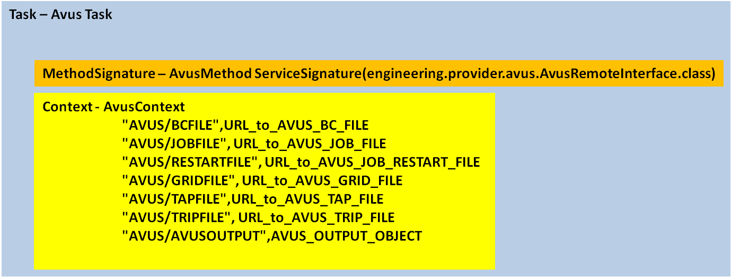
ContextFilter(“AVUS/AVUSOUTPUT”)
AVUS_OUTPUT_OBJECT
ObjectFilter(“windAxisLpus”)
LPUS_ARRAY
ListFilter(i)
LPUS_i

Slide 180
Functionally we see that and which can be written as
.
This is the functional composition to be represented in SORCER. is the dynamic pressure derived from the free stream velocity and the fluid density . The SORCER computing environment is depicted in. For the current discussion we will focus on the development of the Model aspect of this figure

Slide 181
As can be seen in SORCER Models consists of three components, Variables, Evaluators, and Filters. The purpose of this example is to take the engineering functional realationship defined in and create a Model in SORCER. Currently SORCER has three types of models, ResponseModel, ParametricModel, and SensitivityModel. In the near future an OptimizationModel will be incorporated as well. Here we will show the development of each of the three available models. First, the development of a ResponseModel will be demonstrated. This will require the definition of the Model, the Variables, and then the configuration of the Variables with the appropriate Filters and Evaluators.
For the case depicted in there are a total of 21 design variables, 20 design variables associated with and one design variable associated with . The remaining control surface varibles will be “linked” (a set relationship) to . The response variables consists of the 20 lift per unit span values, , and the induced drag, . The primary classes that are used to develop the model can be found in the engineering.avus.requestor and engineering.avus.provider packages. The class names are AvusModeler.java and AvusModelConfigurator.java, InducedDrag.java, and AvusOutput.java.
Below are the significant statements and steps required to build the model.

Slide 182
Define the Model and Variables - This can be done in one step with the following functional composition syntax.
ResponseModel avusRM = responseModel("Induced Drag Response Analysis",
designVars("cs",20),
designVars("alpha"),
linkedVars("cs", 20,21),
responseVars("lpus", 20),
responseVars("iDrag"));
This is a function with embeded statements. An instance of ResponseModel is created called avusRM, the name of the model is “Induced Drag Response Analysis”. This name is arbitrary and user specified. The next argument in the constructor is
DesignVars("cs",20) - Returns a list of 20 Variable objects with the type attribute set to “DESIGN” and names “cs1”, “cs2”, ... “cs20”.
DesignVars("alpha") - Returns a single Variable object with type attribute of “DESIGN” and name “alpha”
LinkedVars("cs", 20,21) - Returns a list of 20 Variable objects with type attribute “DESIGN” and kind attribute of “LINKED” with names “cs21”, “cs22”, ...”cs40”
ResponseVars("lpus", 20)- Returns a list of 20 Variable objects with type attribute of “RESPONSE” with names “lpus1”, “lpus2”, ...”lpus20”
ResponseVars("iDrag")Returns a Variable object with type attribute of “RESPONSE” with name “iDrag”
A formal definition of the Variable class and some of its available attributes can be found in Appendix A.
2. The next step required is to configure the DesignVariables, LinkedVariables, and the ResposneVariables.
a. configure the Design Variables - Each indepenedent design variable consists of zero, one, or more Filters. For this case the independent design variables reside in two locations. The variables reside in an ascii text file( AVUS_Boundary_Condition.dat) and resides in a separate ascii text file (AVUS_Job.job). In order to have the ability to get and set the values in these files from anywhere on the network (we have no idea where avus may run) we need to create Filter objects and place them into the Variables. Filters take a larger entity and “filter” out a portion of that entity for either reading, writing or passing to another filter. Since we are working with ascii text files in this case we will create BasicFileFilter objects (a list of the all currently available Filter types can be found in the sorcer.vfe.filter package) . Each BasicFileFilter requires a Pattern object which is used to locate the desired quantity in the entity. Here our pattern is essentially line, field, delimeter information. Other patterns such as regular expressions are available as well. Below is an excerpt from the AVUS_Boundary_Condition.dat file and the AVUS_Job.job file(the line numbers are not actually in the file. They are shown here to indicate where in the file the excerpt has been taken from).

Slide 183
Modified One Point Approximation (MOA)
Apply SOA to the lift per unit span F_{i} not to D_{I}

Slide 184
Kriging Approximation
Is a generalized regression model (often chosen as a constant in practice)
Are a set of chosen basis functions
Are found by solving
(least squares if R is identity)
Is a correlation matrix
Vector of known responses at random sampling points

Slide 185
Kriging Approximation
is one realization of a Gaussian process with mean of zero, variance , and a covariance that satisfies
Is the correlation function. Two considered in this work are
(Gaussian correlation function)
(Cubic Spline correlation function)

Slide 186
SORCER is a Service-Object-Oriented Architecture
A service-oriented product development environment
Provides an open flexible design environment which allows universal availability and incorporation of existing data, tools/methods, processes and hardware as services.
Provides a common way to model your analysis and design process in conjunction with your product data.
A network-based distributed framework
Supports collaboration among geographically distributed engineering and business partners.
SORCER Philosophy – Accessibility, Flexibility & Reusability
SORCER is Research Code!

Slide 187
Service Oriented Computing EnviRonment - SORCER
A service-oriented product development environment
SORCER is a programming and computing environment that enables one to perform large scale system level engineering analysis and design space exploration that may be in a distributed heterogeneous computing environment.
SORCER federates a series of Service Providers (which may be distributed) in real time and orchestrates the communication between the Service Providers based on a Control Strategy algorithm defined in an Exertion(process definition) to perform a multi-disciplinary analysis and or design space exploration.

Slide 188

Service Oriented Computing EnviRonment - SORCER
A network-based distributed framework
Service Oriented
Neutrality:
Location
Protocol
Implementation
Mobile
Proxy
Object
Discovery & Register
Discovery & Lookup
Service
Registry
Service
Proxy Object
Service
Provider
Requestor

Slide 189
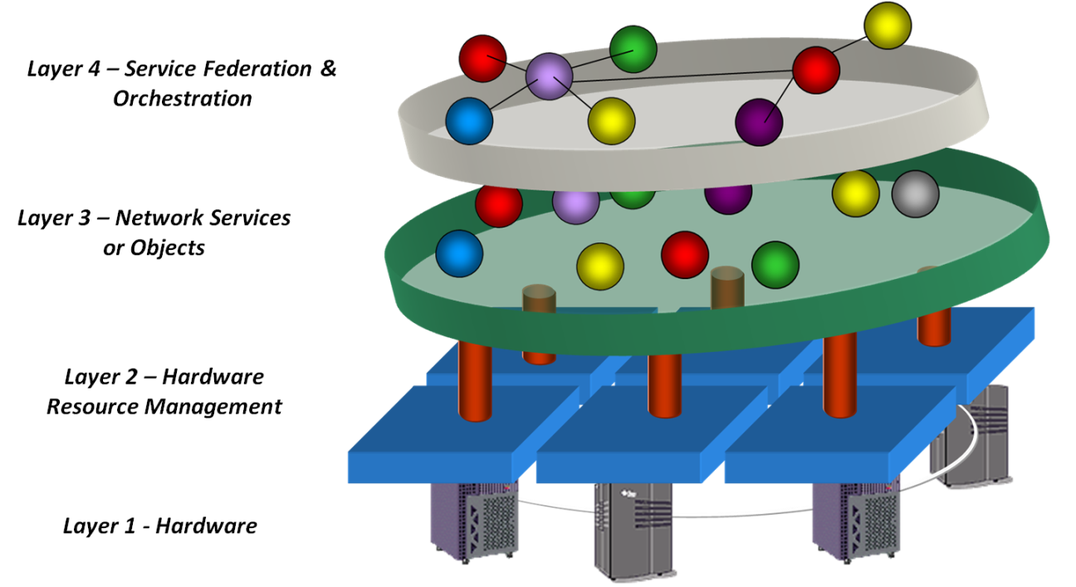
SORCER Paradigm
Models
Filters
Exertions
Evaluators
Service Context
Variables
Metacomputer
Signatures
EO Programming
Control Context
Providers
SORCER meta-OS
Service Context
Metaprocessor
(Services)
Computers
Service Types
Programming Env
Implementation
OS
Processor

Slide 190
SORCER Terminology
Service provider : a remote object accepting exertions from service requestors and performs calculations. Can provider one or more services.
The grid: a collection of service providers on the network.
Exertion (think process representation or workflow): defines collaborations - service-oriented programs. An object that represents a process by specifying the relationship between services and the information passed between them.

Slide 191
Service Providers
Wrap existing applications with java to expose one or more functionalities(services) of the application to the SORCER Environment
Public class xxxProvider extends ServiceProvider implements xxxRemoteInterface, SorcerConstants{ }
Tight integration with c, c++, fortran etc.. using jna, jni and swig. Allows interaction at the api level not at the file level. More efficient and robust.
Robustness & Reuse
Your Computational Environment is only as good as your Wrapping!

Slide 192
Exertion
Elementary Exertion
Composite Exertion
Engineering Example
Job
Job
.
.
.
All are Objects

Slide 193
SORCER Paradigm
Models
Filters
Exertions
Evaluators
Service Context
Variables
Metacomputer
Signatures
EO Programming
Control Context
Providers
SORCER meta-OS
Service Context
Metaprocessor
(Services)
Computers
Service Types
Programming Env
Implementation
OS
Processor

Slide 194
Variable, Evaluator, Filter (VEF) Design Patterns
Lazy variable evaluation
getValue vs. evaluate (demand driven calculations)
Evaluator – Decorator pattern
Evaluator: getValue/evaluate implements EvaluationManagement
Outer evaluator calls on its inner one
Evaluator is observable and observer (functional programming)
Observer-Observable
setChanged
notify/update
Notes:
Function composition is a very powerful way of reusing code and building programs from pieces.
Object composition provides good support for building software from pieces.
Building complete partial results can be a waste of resources, as the next function in the composition chain may need only a few first elements from the partial result variable list, so computing the rest of the list would be a waste of time.
A variable is a generator that, on request (getValue), provides a response-object.

Slide 195
Evaluators
Evaluators – are used to determine the value of variables and their partial derivatives(chain rule works) with respect to their dependencies (Variables). Evaluators do not necessarily produce a scalar value. The result can be an entire database or file. (for a given set of input an application creates many outputs)
Current Evaluator Types – ModelEvaluator, ExertionEvaluator, ExpressionEvaluator, GroovyEvaluator, JepEvaluator, MethodEvaluator, SOAEvaluator, FDEvaluator

Slide 196
Filters
Filters - are used to map the results of Evaluators to Variable Values. Think unix shell piping. Filters take the output of Evaluators and reduce it to a single scalar value necessary to define a Variable value. Filters can be concatenated n times.
Current Filter Types – BasicFileFilter, ContextFilter, FileFilter, GrepFilter, ListFilter, MapFilter, ObjetFilter, PatternFilter, TextFilter

Slide 197
Objective Function, Constraints and Sensitivities
Objective Sensitivities:
Constraints Sensitivities:

Slide 198
Modified One Point Approximation (MOA)
Apply SOA to the lift per unit span F_{i} not to D_{I}

Slide 199
Kriging Approximation
Is a generalized regression model (often chosen as a constant in practice)
Are a set of chosen basis functions
Are found by solving
(least squares if R is identity)
Is a correlation matrix
Vector of known responses at random sampling points

Slide 200
Kriging Approximation
is one realization of a Gaussian process with mean of zero, variance , and a covariance that satisfies
Is the correlation function. Two considered in this work are
(Gaussian correlation function)
(Cubic Spline correlation function)

Slide 201
Modified One Point Approximation (MOA)
Apply SOA to the lift per unit span F_{i} not to D_{I}

Slide 202
Kriging Approximation
Is a generalized regression model (often chosen as a constant in practice)
Are a set of chosen basis functions
Are found by solving
(least squares if R is identity)
Is a correlation matrix
Vector of known responses at random sampling points

Slide 203
Kriging Approximation
is one realization of a Gaussian process with mean of zero, variance , and a covariance that satisfies
Is the correlation function. Two considered in this work are
(Gaussian correlation function)
(Cubic Spline correlation function)

Slide 204
SORCER is a Service-Object-Oriented Architecture
A service-oriented product development environment
Provides an open flexible design environment which allows universal availability and incorporation of existing data, tools/methods, processes and hardware as services.
Provides a common way to model your analysis and design process in conjunction with your product data.
A network-based distributed framework
Supports collaboration among geographically distributed engineering and business partners.
SORCER Philosophy – Accessibility, Flexibility & Reusability

Slide 205
Service Oriented Computing EnviRonment - SORCER
A service-oriented product development environment
SORCER is a programming and computing environment that enables one to perform large scale system level engineering analysis and design space exploration that may be in a distributed heterogeneous computing environment.
SORCER federates a series of Service Providers (which may be distributed) in real time and orchestrates the communication between the Service Providers based on a Control Strategy algorithm defined in an Exertion(process definition) to perform a multi-disciplinary analysis and or design space exploration.

